Slide 1
DAO-CP (proposed)
DTD
OnlineCP
DAO-CP (proposed)
DTD
OnlineCP
Full-CP
DAO-CP (proposed)
DTD
OnlineCP
Full-CP
Video (Rank 10)
Video (Rank 20)
Video (Rank 30)
Video (Rank 40)
Video (Rank 50)
Synthetic (Rank 10)
Synthetic (Rank 20)
Synthetic (Rank 30)
Synthetic (Rank 40)
Synthetic (Rank 50)
Video (Rank 10)
Video (Rank 20)
Video (Rank 30)
Video (Rank 40)
Video (Rank 50)
Stock (Rank 10)
Stock (Rank 15)
Stock (Rank 20)
Stock (Rank 25)
Stock (Rank 30)
Hall (Rank 10)
Hall (Rank 15)
Hall (Rank 20)
Hall (Rank 25)
Hall (Rank 30)
Korea (Rank 10)
Korea (Rank 15)
Korea (Rank 20)
Korea (Rank 25)
Korea (Rank 30)

Slide 2
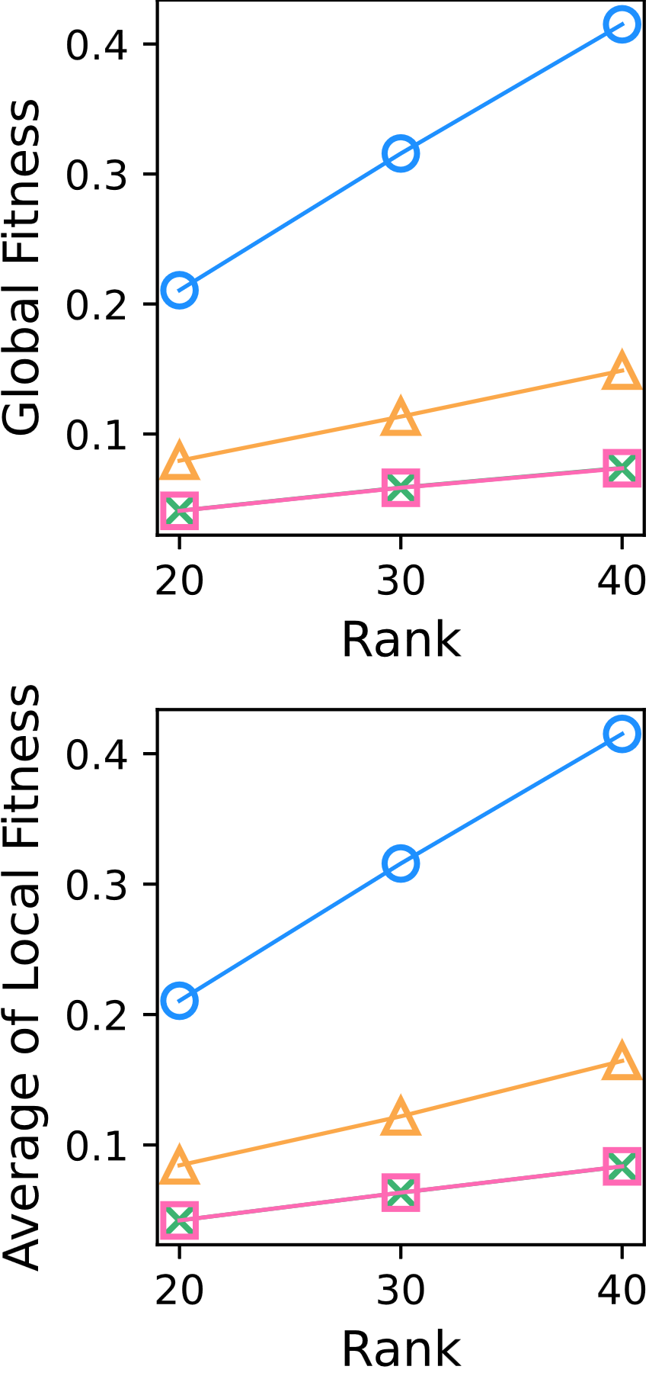
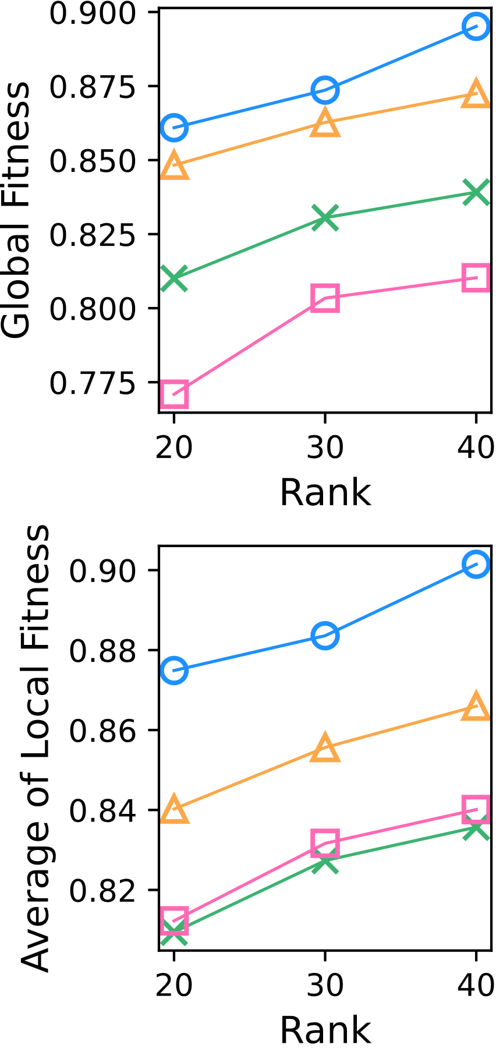
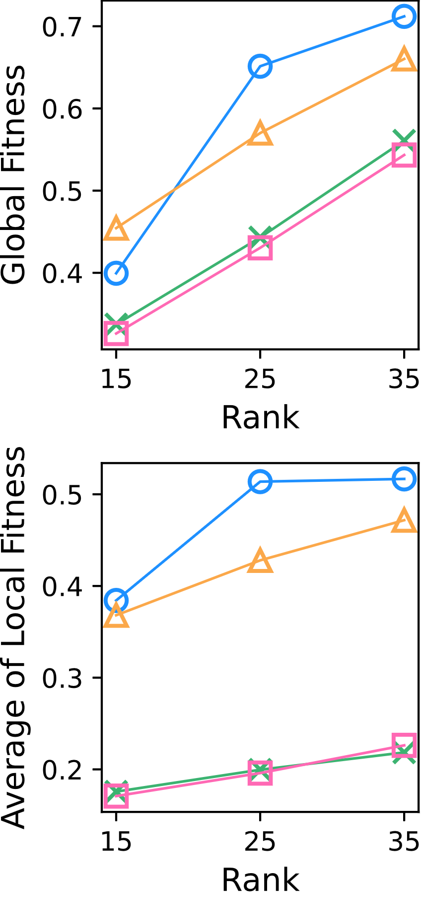
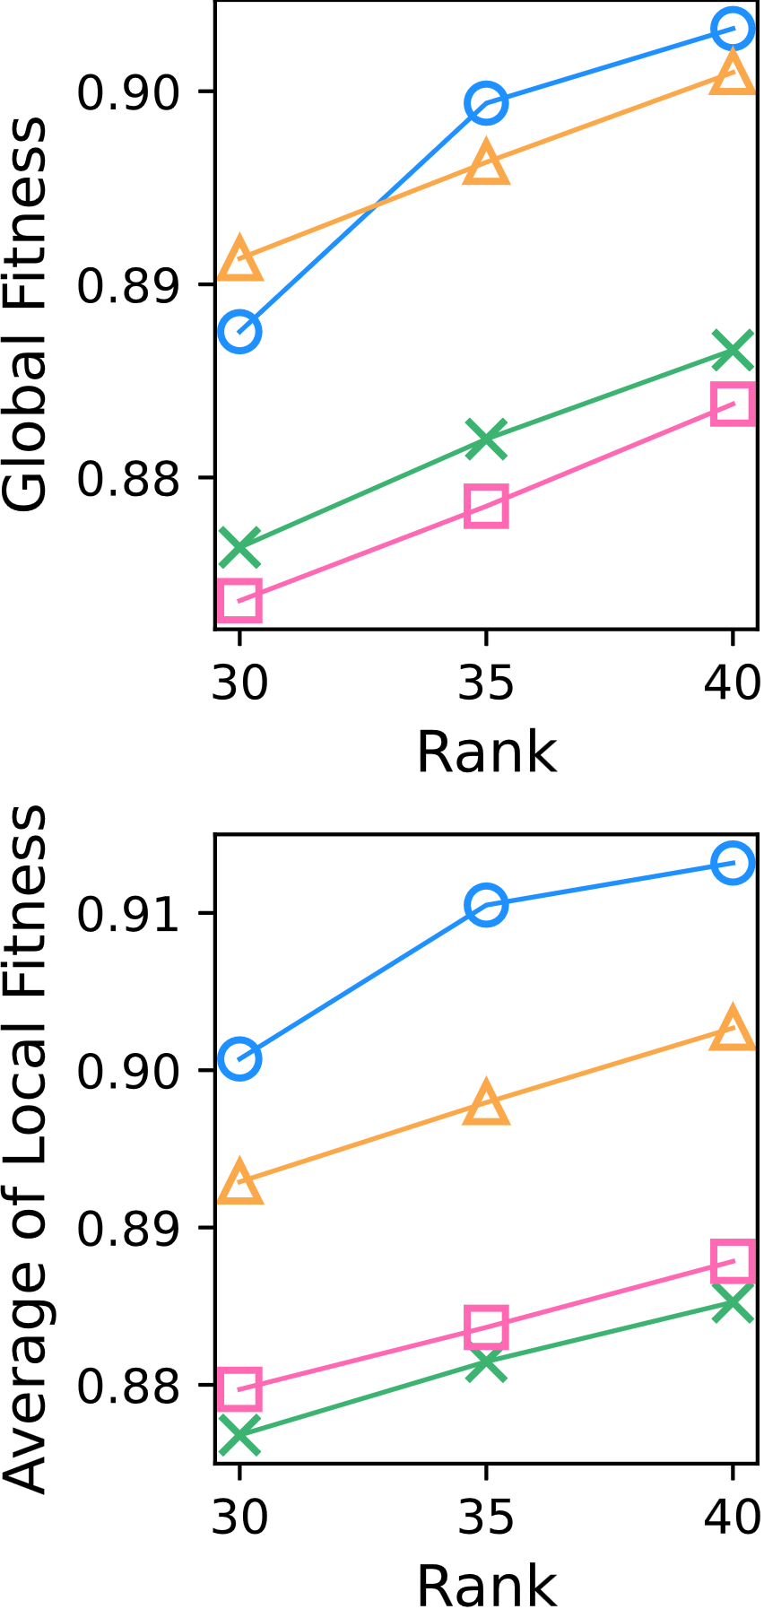
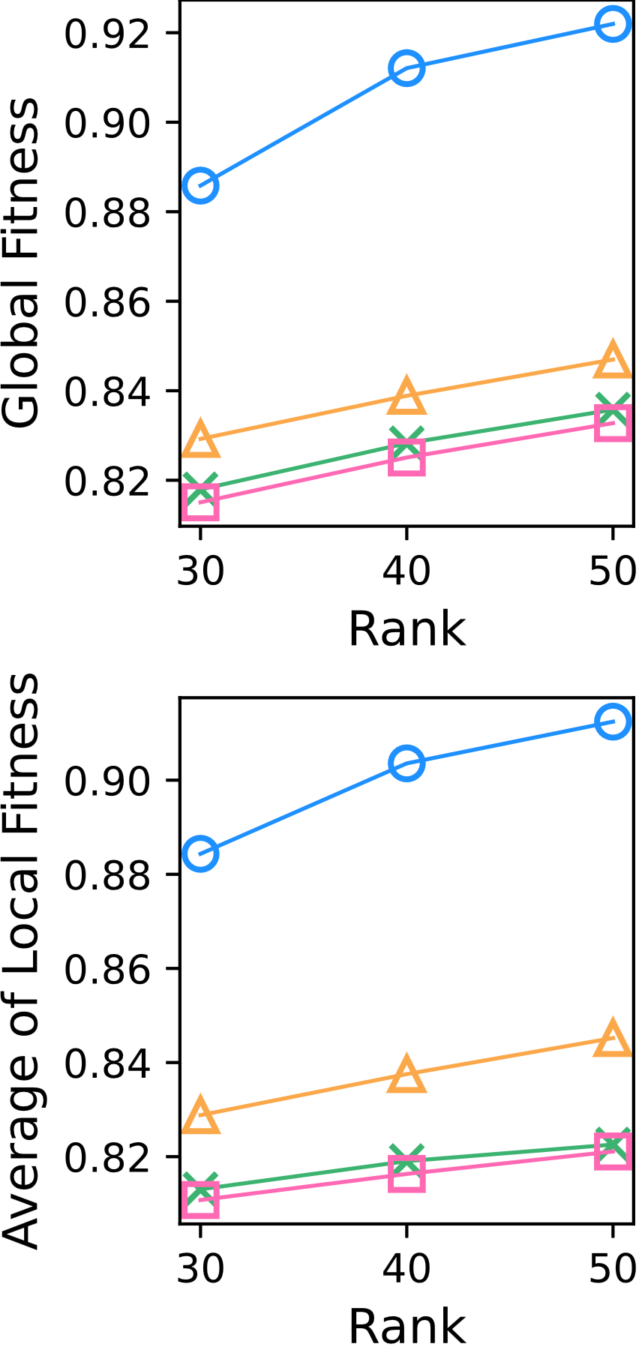
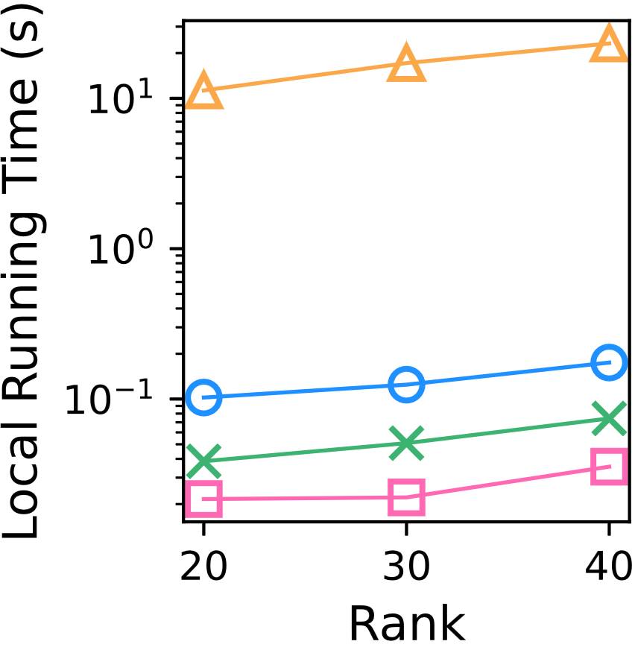
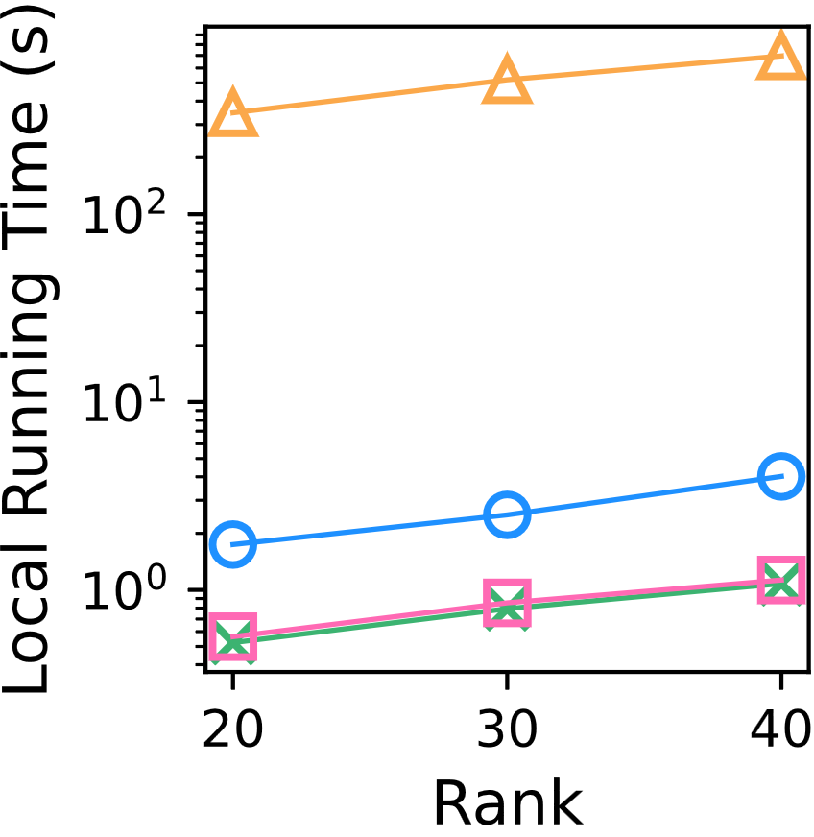
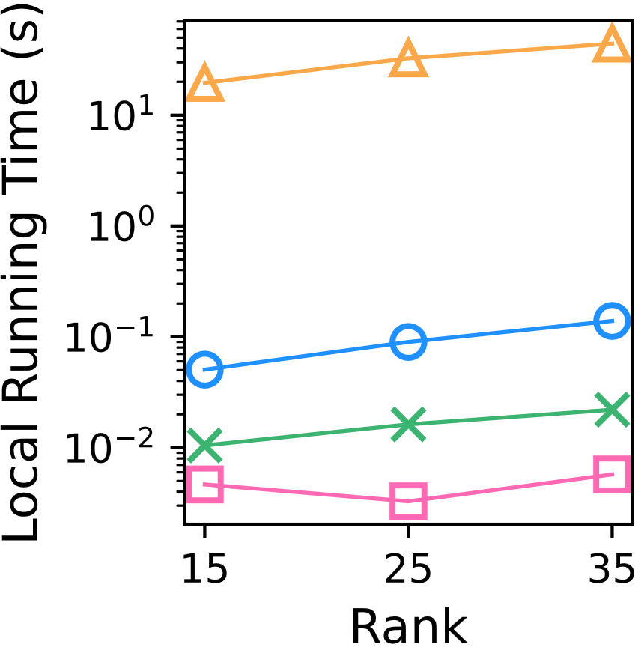
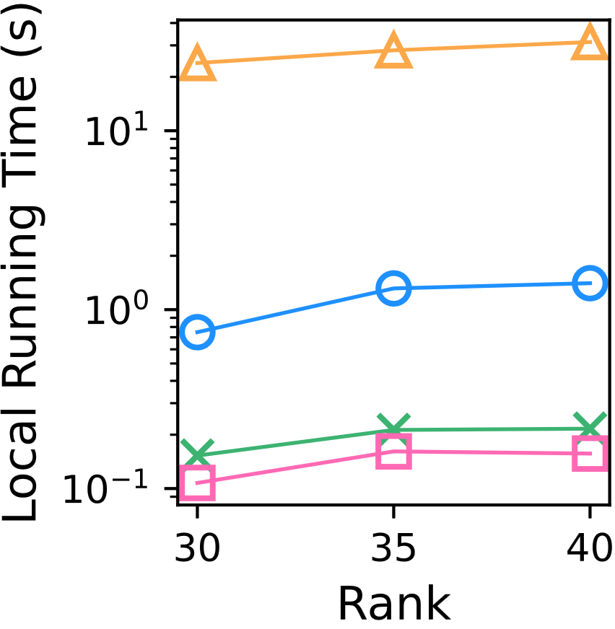
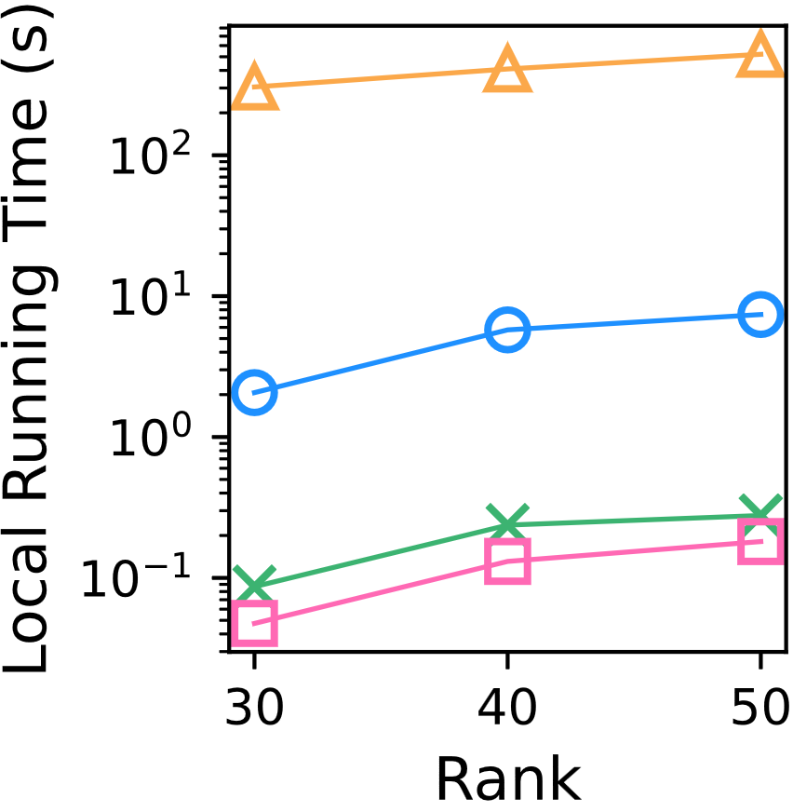
synthetic
video
stock
hall
korea
DAO-CP (proposed)
DTD
OnlineCP
Full-CP
BEST
BEST
BEST
BEST
BEST
BEST
BEST
BEST
BEST
BEST
DAO-CP (proposed)
DTD
OnlineCP
Full-CP
BEST
BEST
BEST
BEST
BEST

Slide 3
Video | Stock | Hall | Korea | Synthetic
DAO-CP (proposed)
DTD
OnlineCP
Full-CP
BEST
BEST
BEST
BEST
BEST
BEST
BEST
BEST
BEST
BEST
DAO-CP (proposed)
DTD
OnlineCP
Full-CP
BEST
BEST
BEST
BEST
BEST

Slide 4
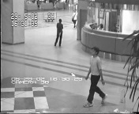
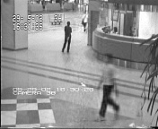
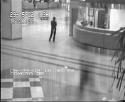
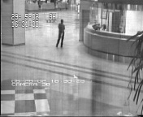
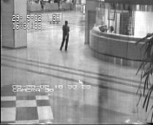






Slide 5
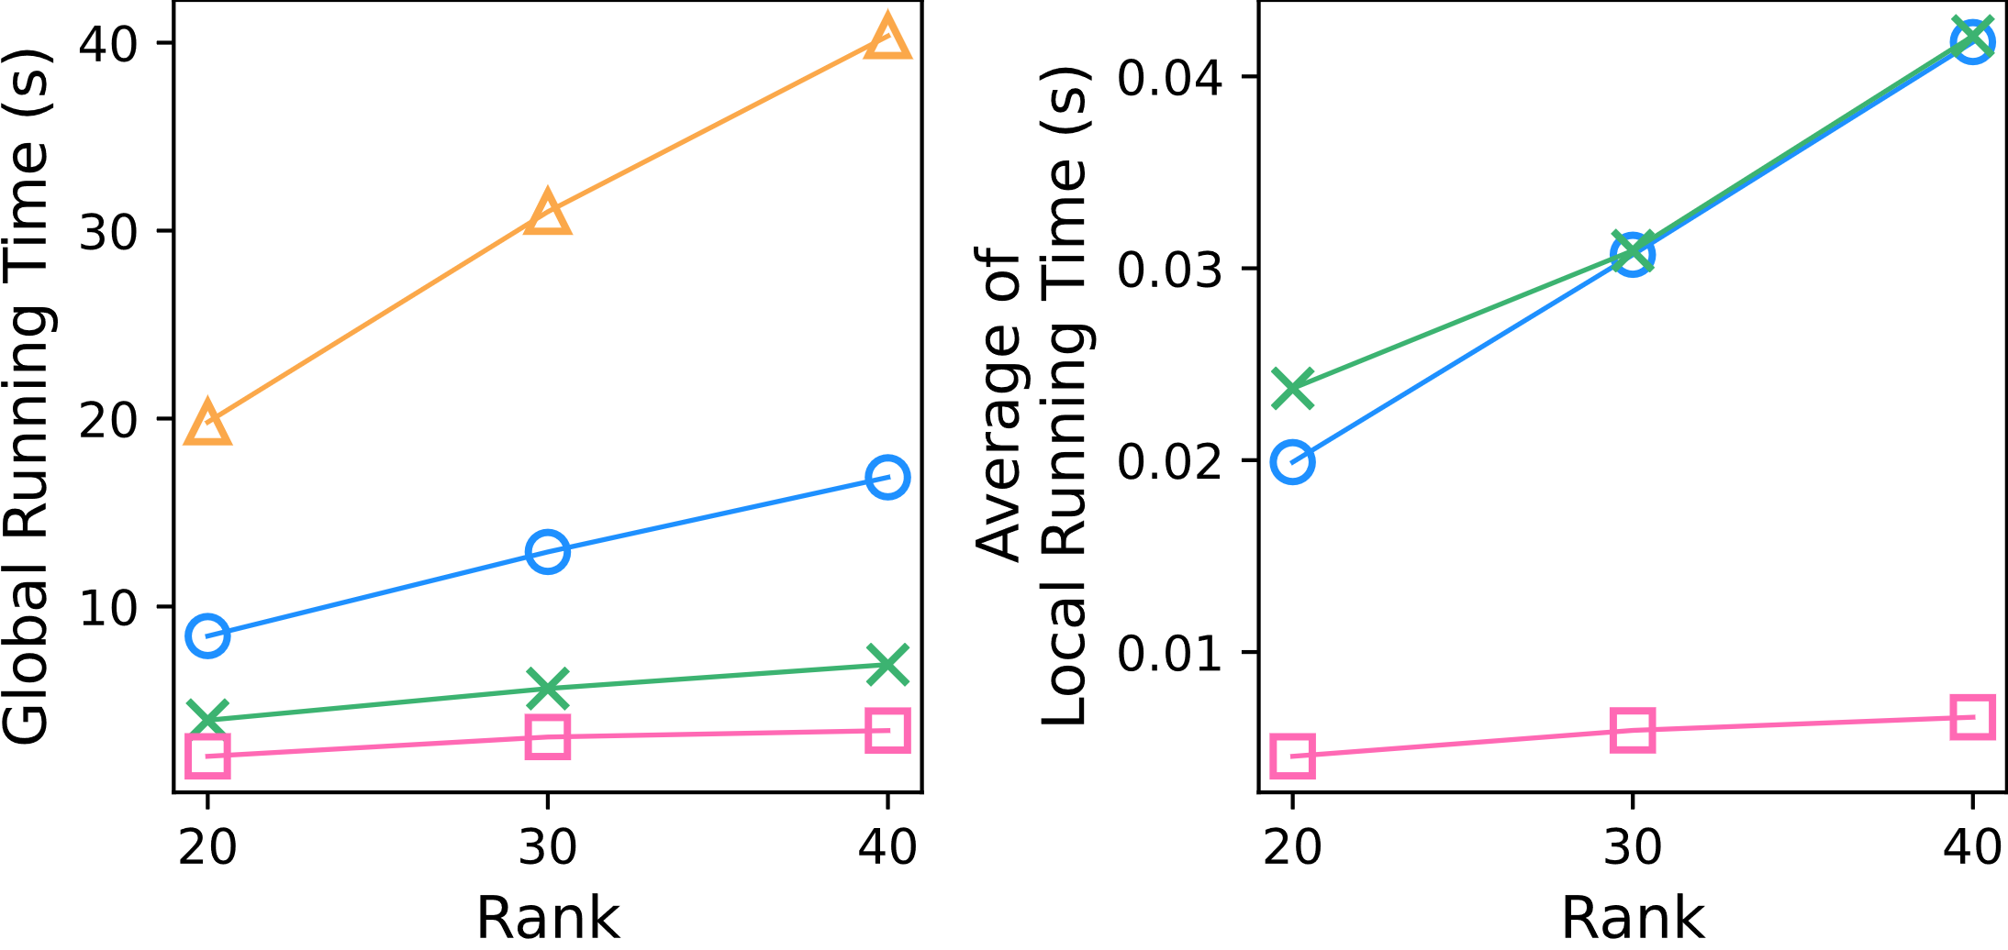
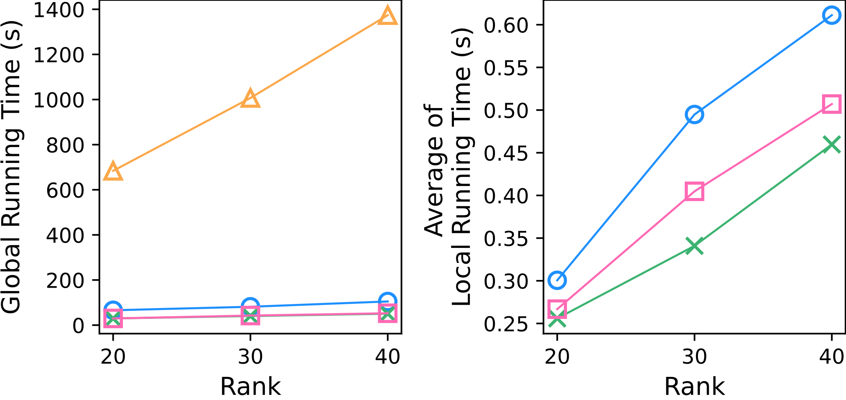
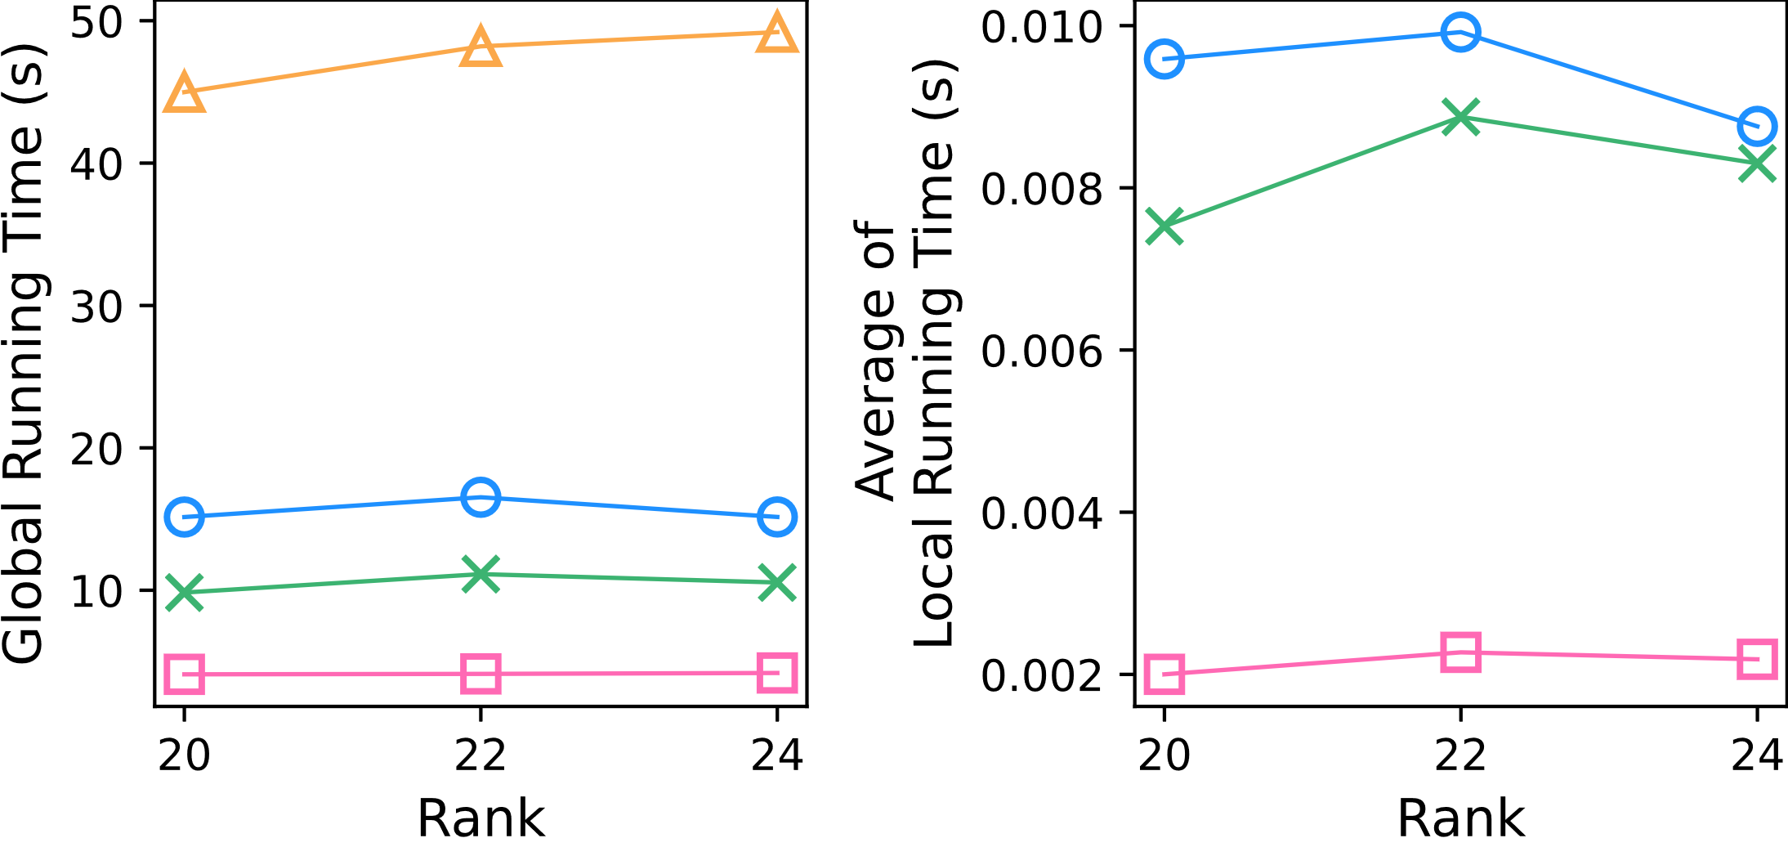
DAO-CP (proposed)
DTD
OnlineCP
Full-CP
BEST
BEST
BEST
BEST
BEST

Slide 6
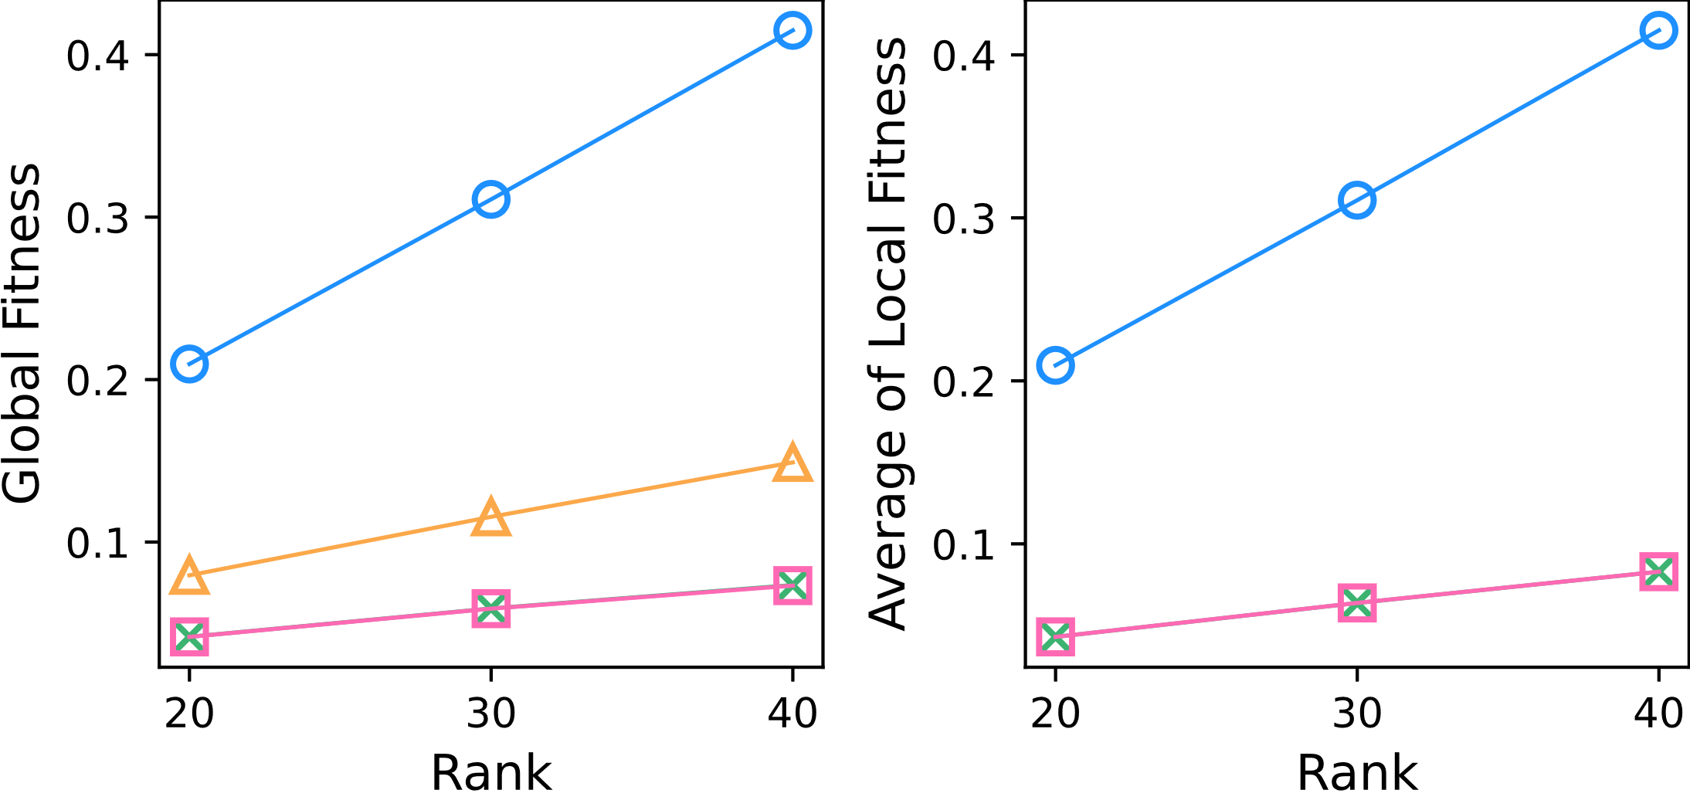
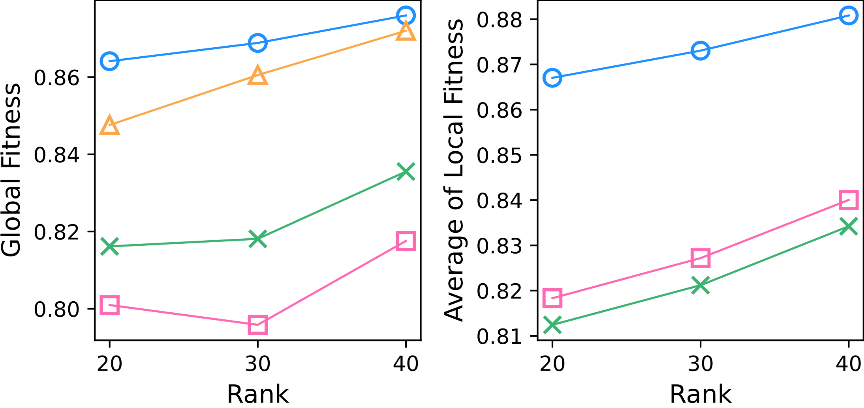
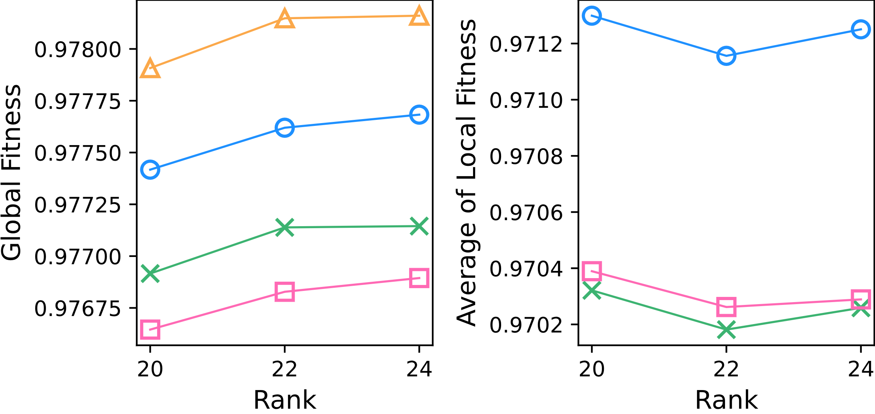
DAO-CP (proposed)
DTD
OnlineCP
Full-CP
BEST
BEST
BEST
BEST
BEST
BEST
BEST
BEST
BEST
BEST
BEST
BEST

Slide 7
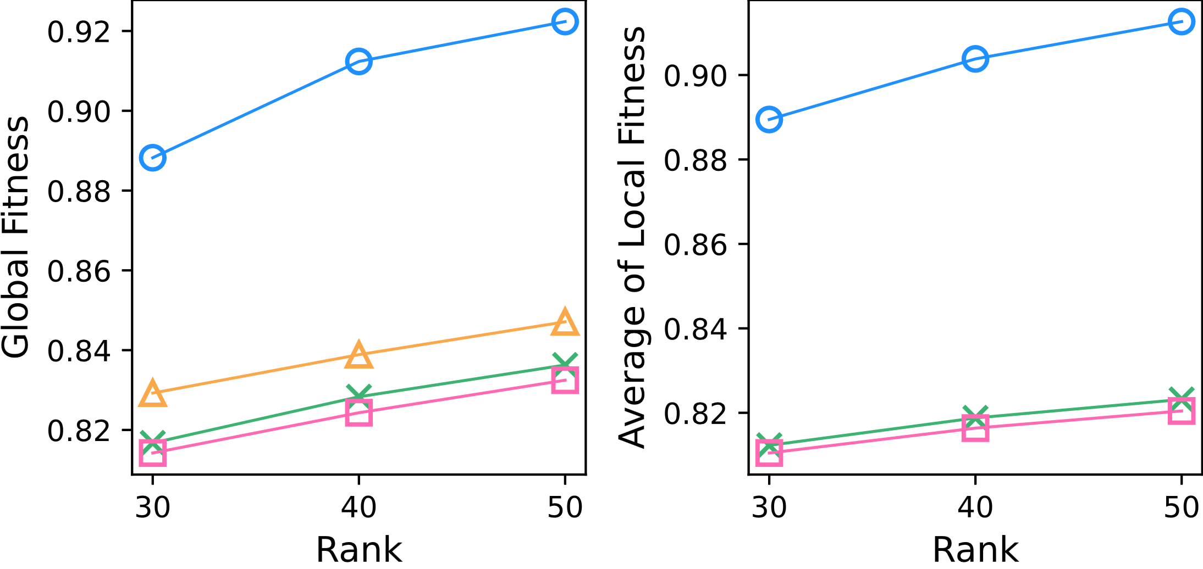
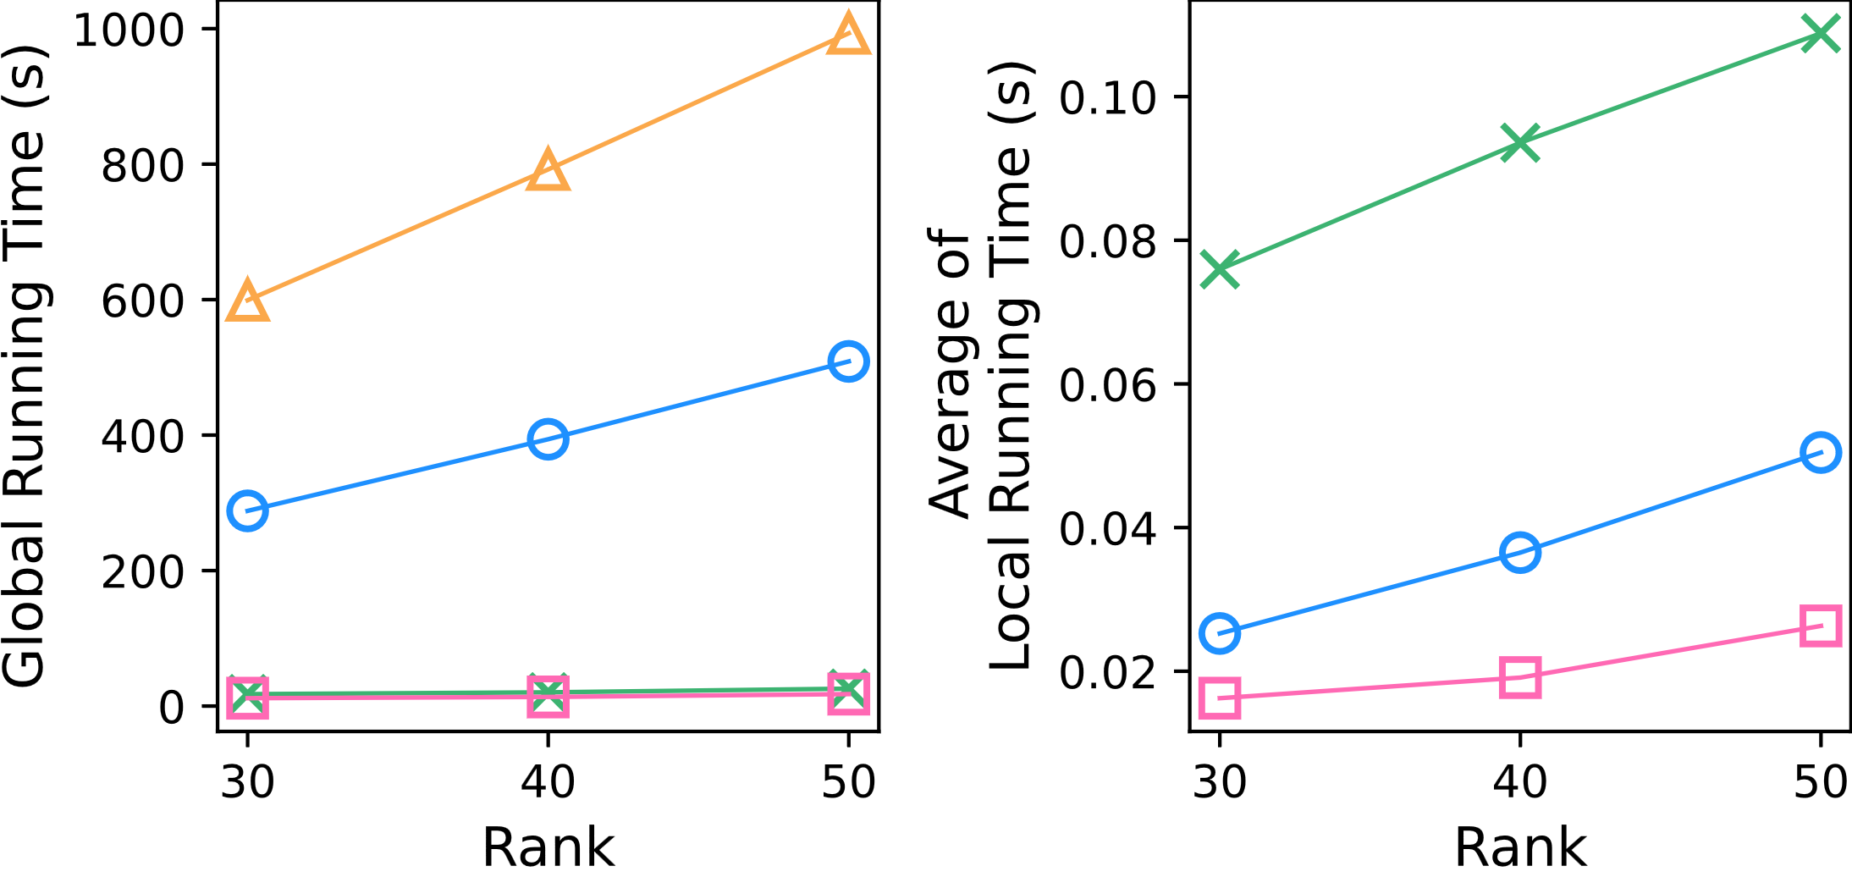
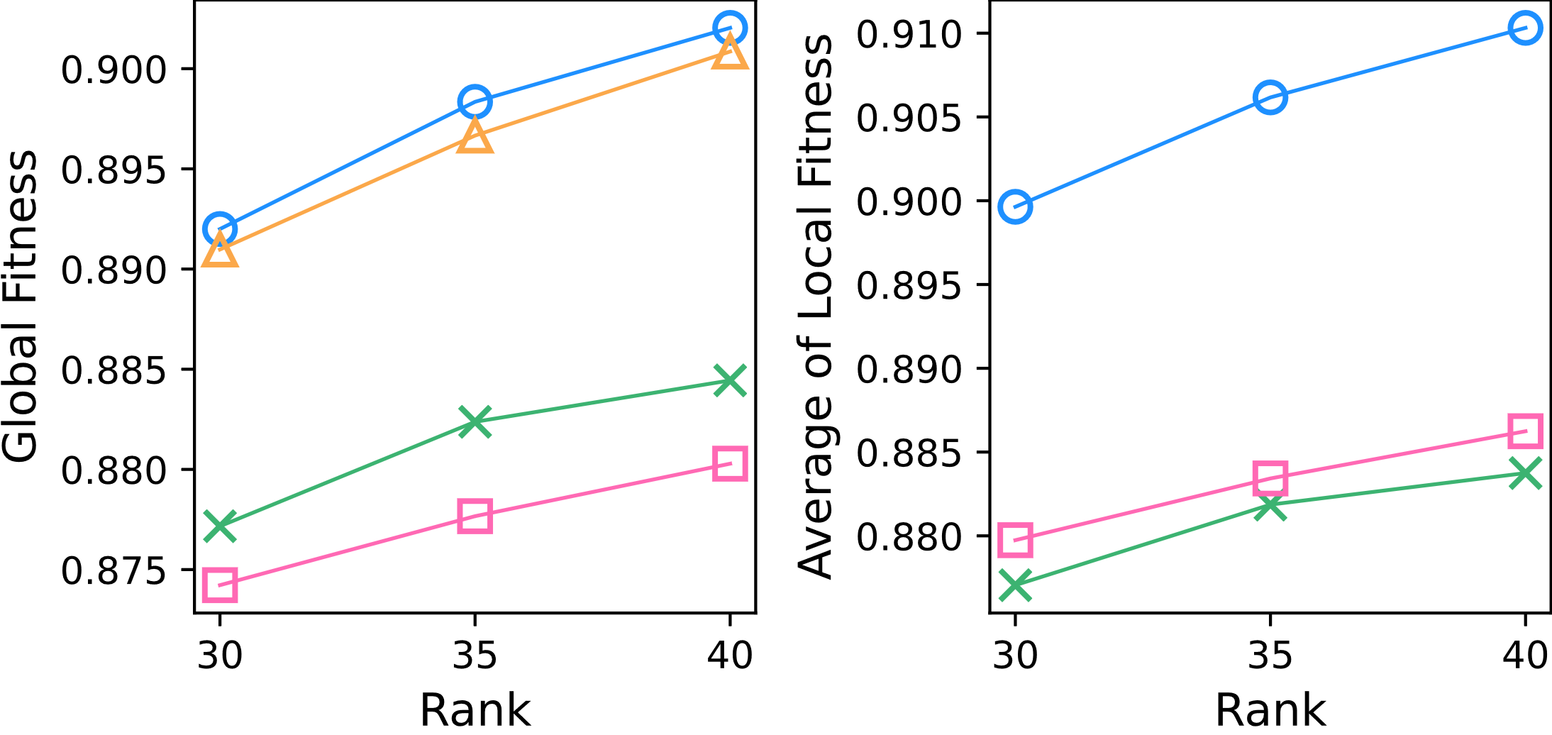
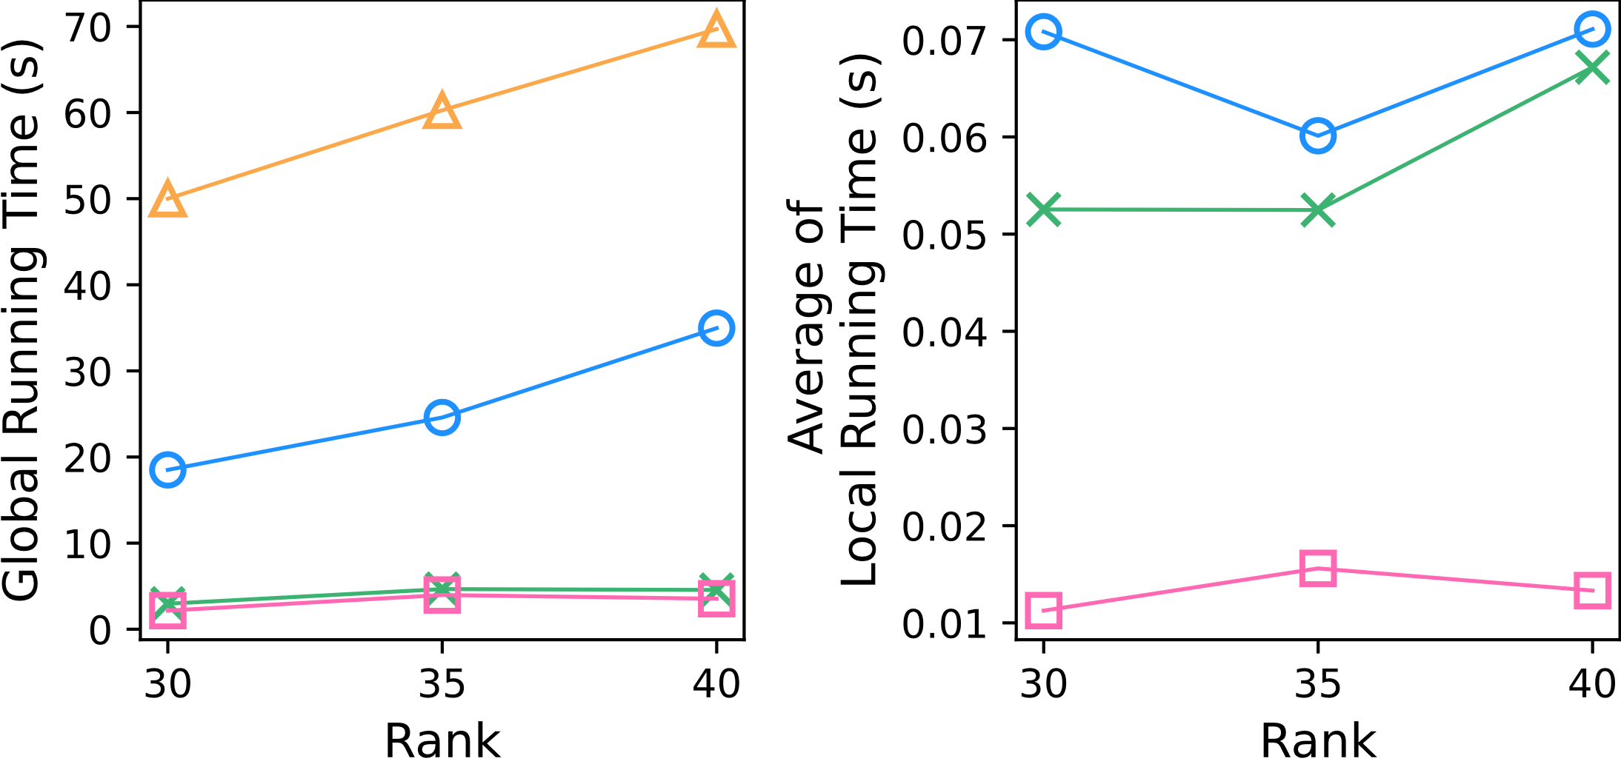
DAO-CP (proposed)
DTD
OnlineCP
Full-CP
BEST
BEST
BEST
BEST
BEST
BEST
BEST
BEST

Slide 8
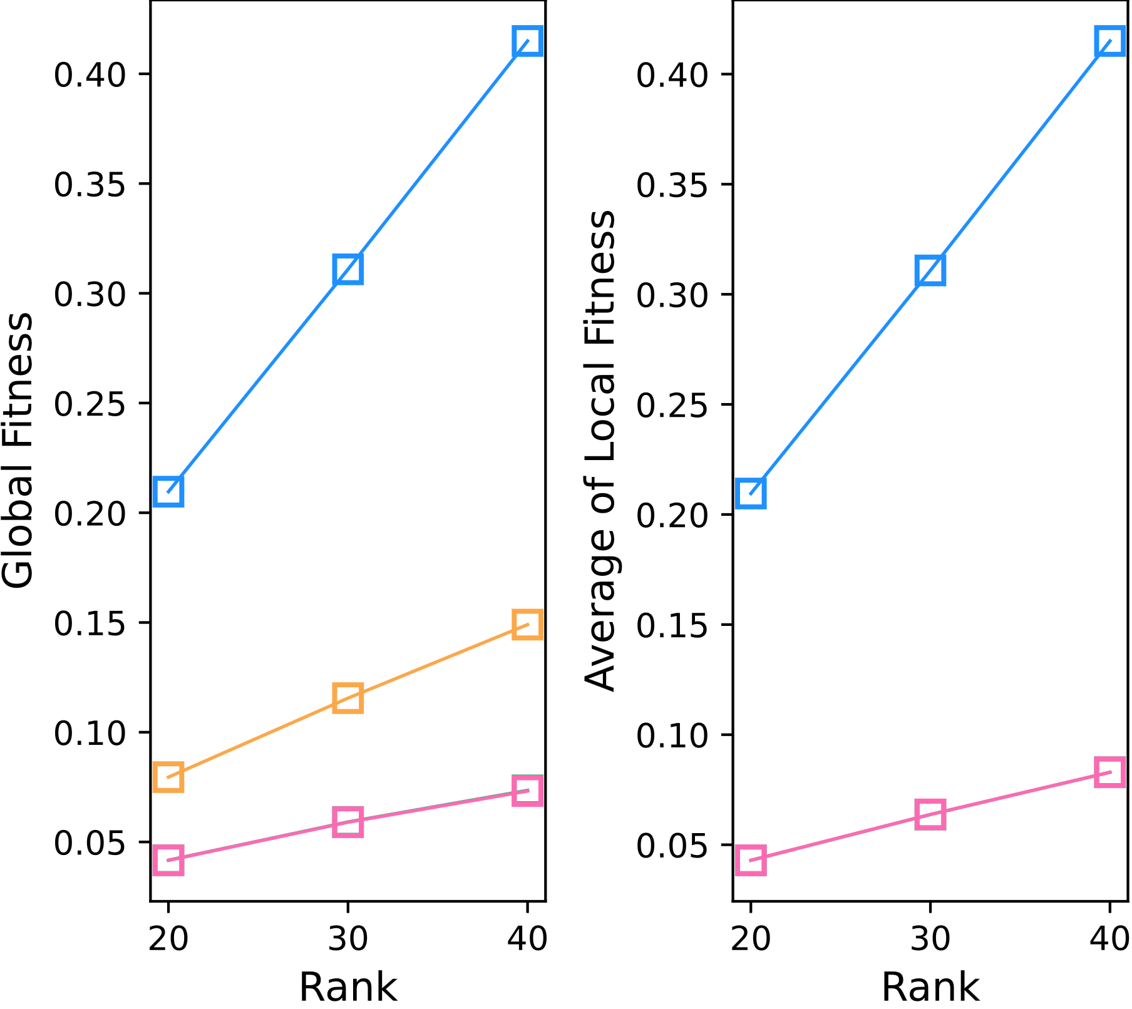
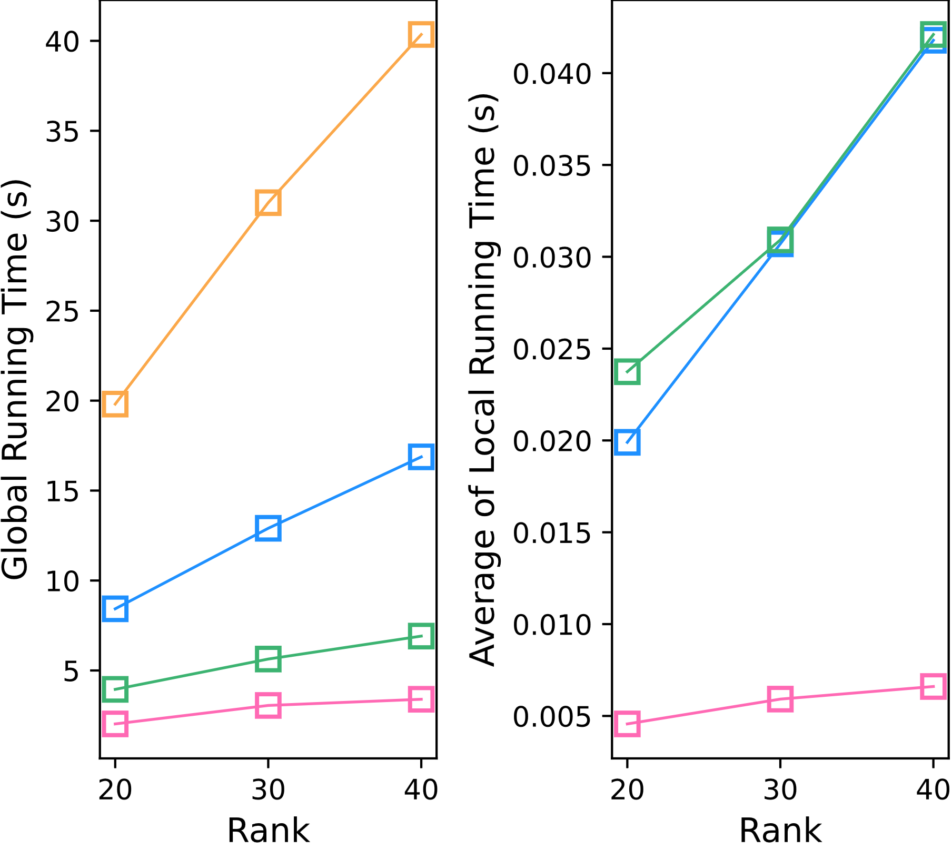
DAO-CP (proposed)
DTD
OnlineCP
Full-CP
BEST
BEST
BEST
BEST

Slide 9
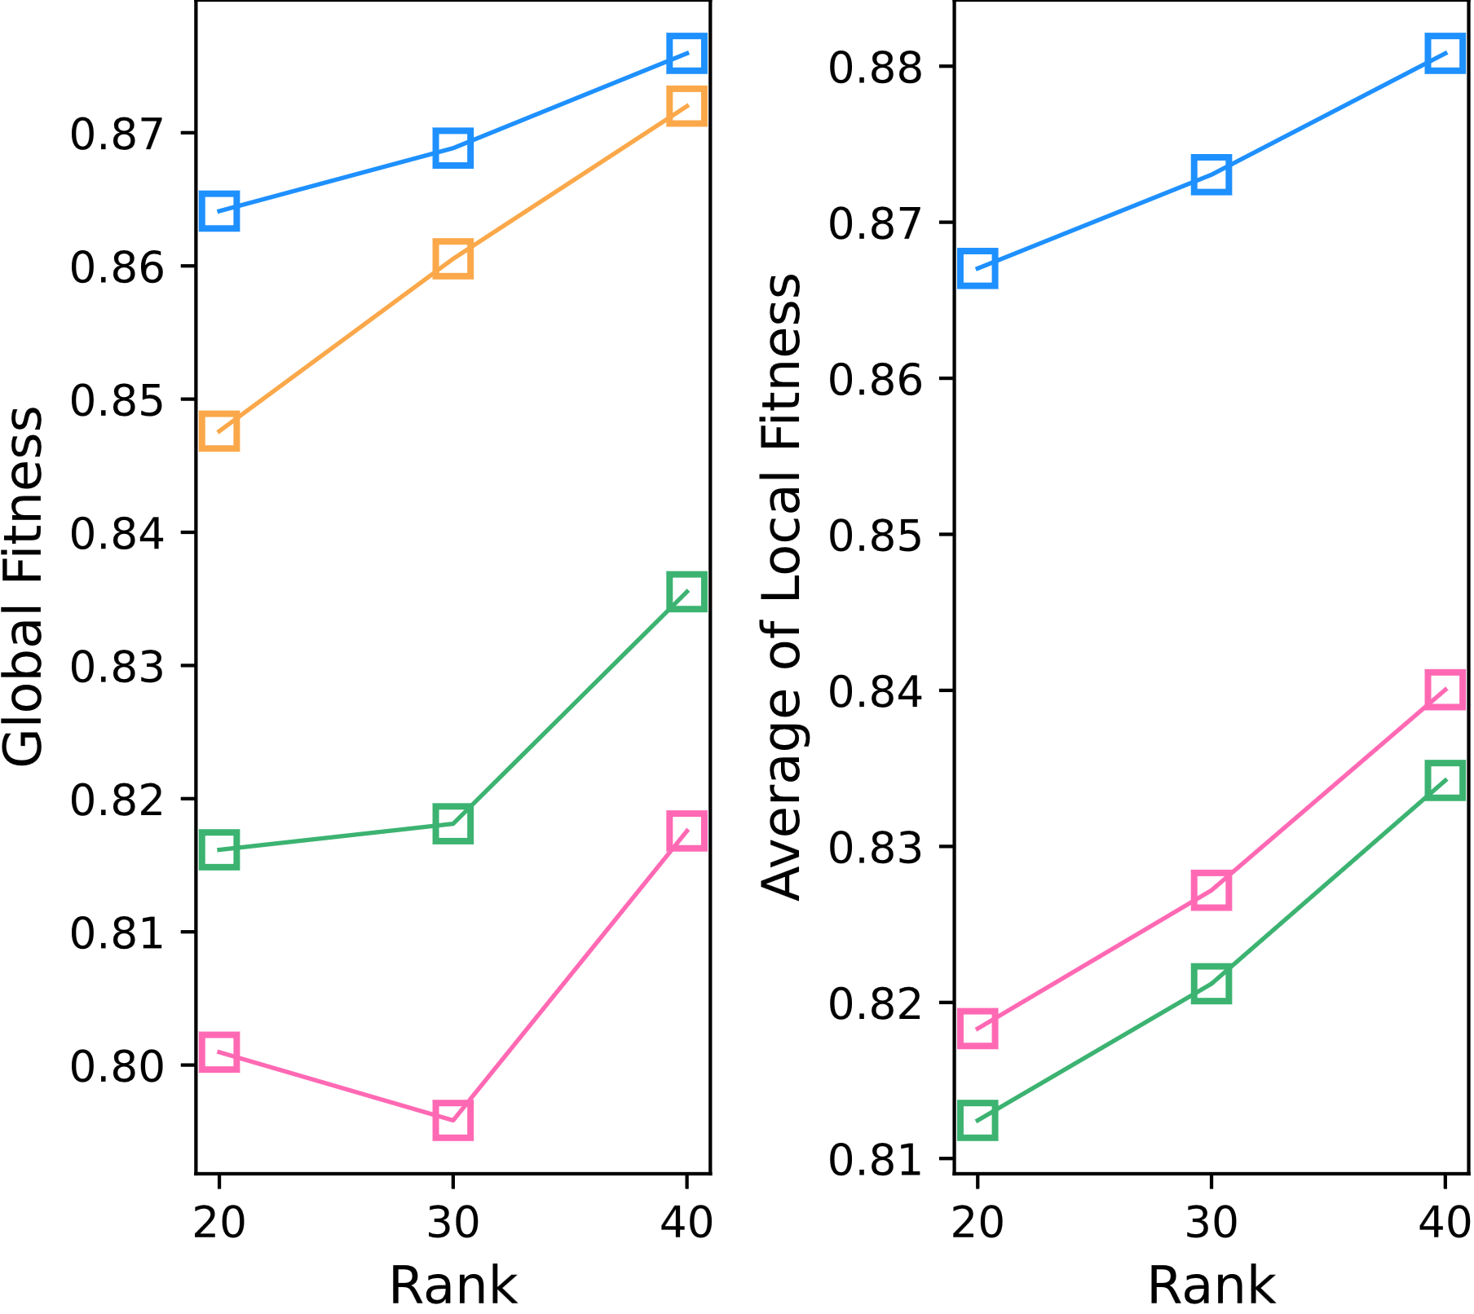
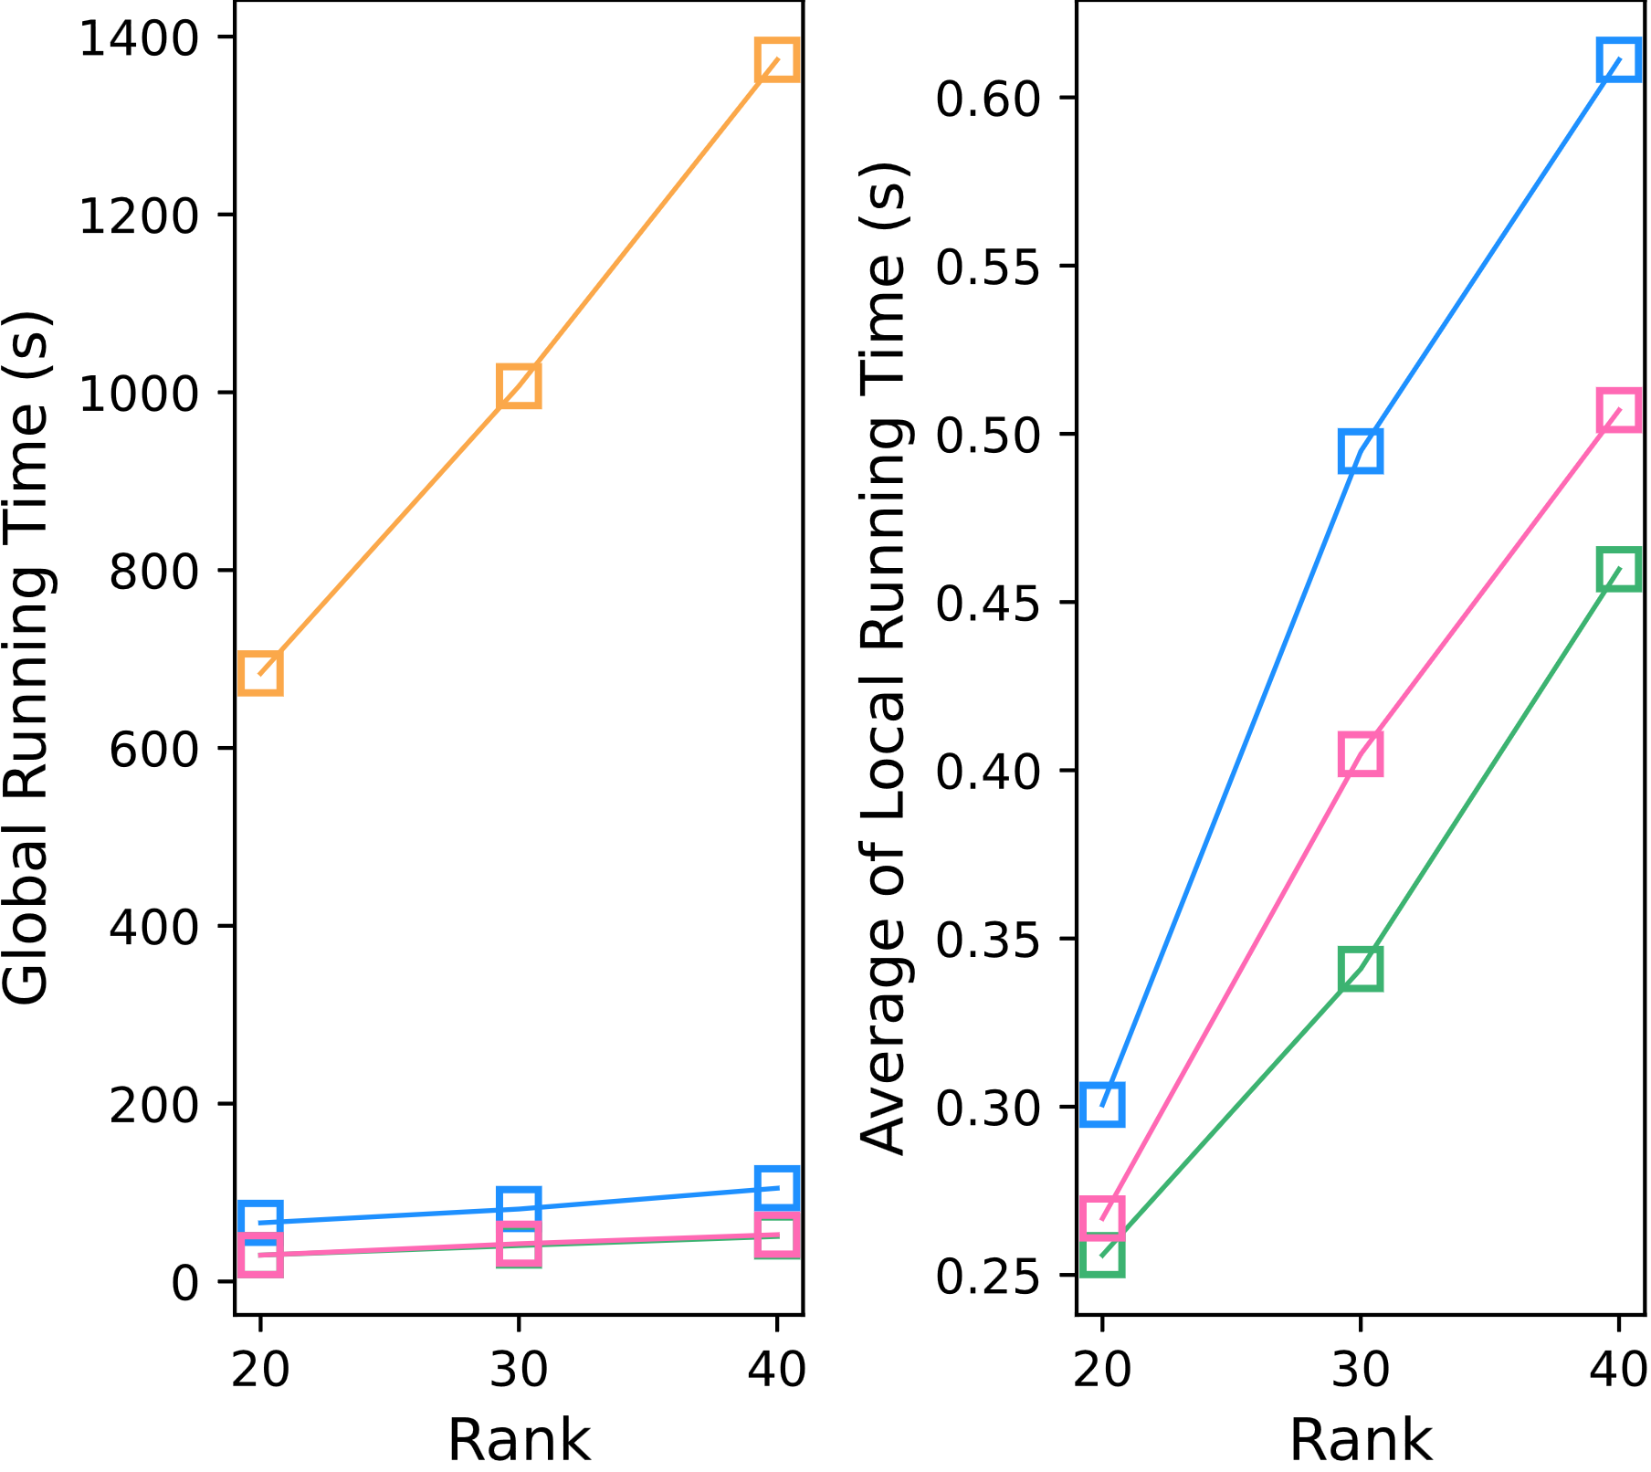
DAO-CP (proposed)
DTD
OnlineCP
Full-CP
BEST
BEST
BEST
BEST

Slide 10
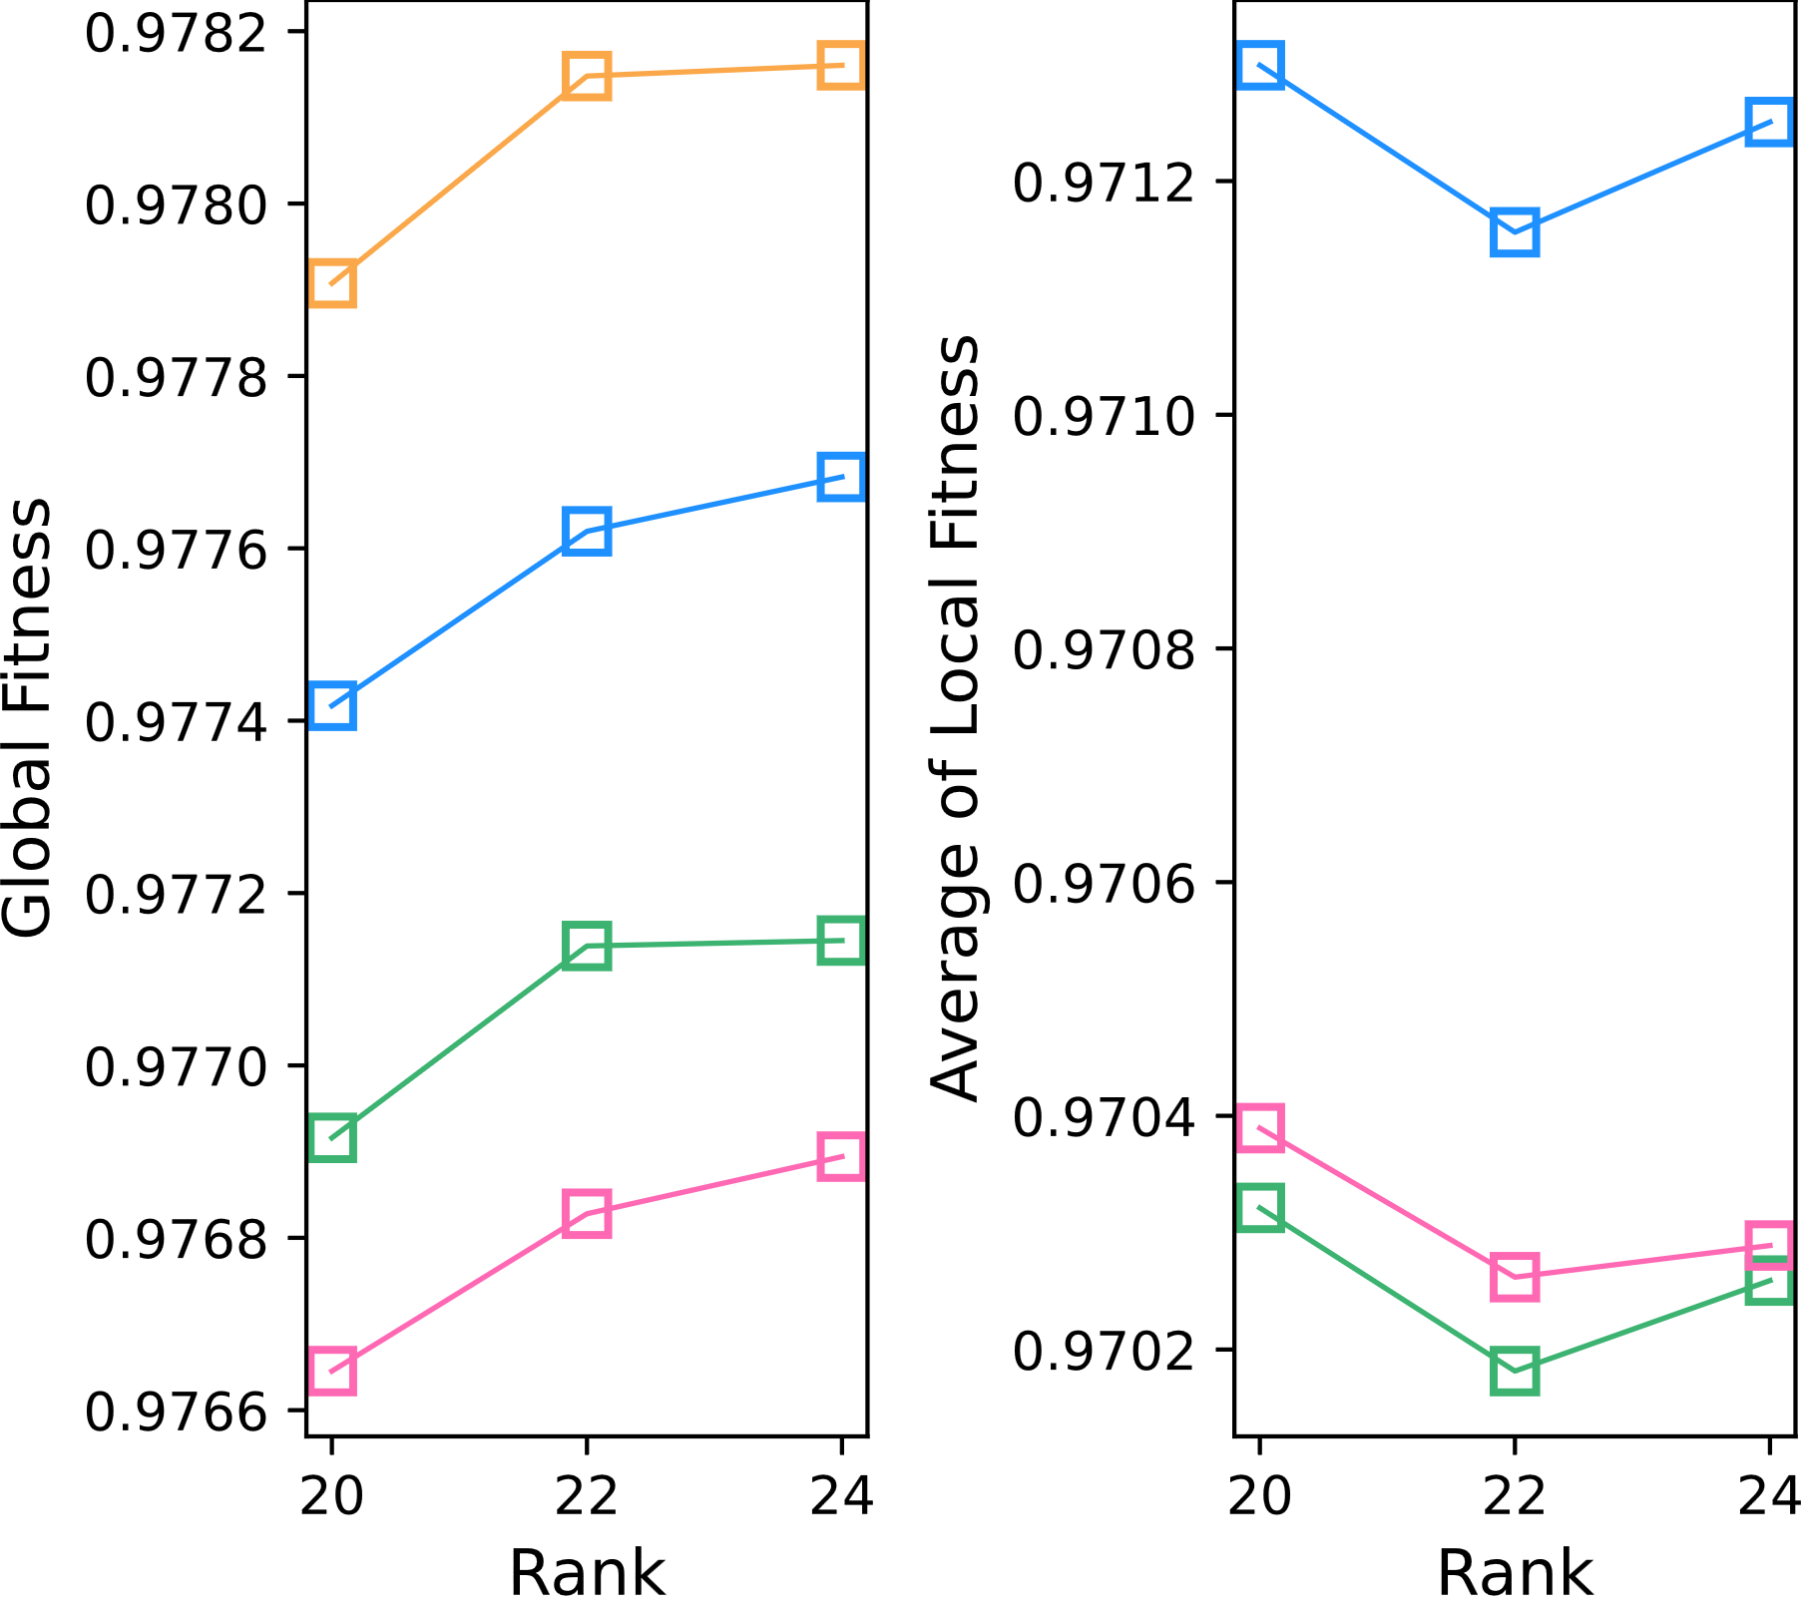
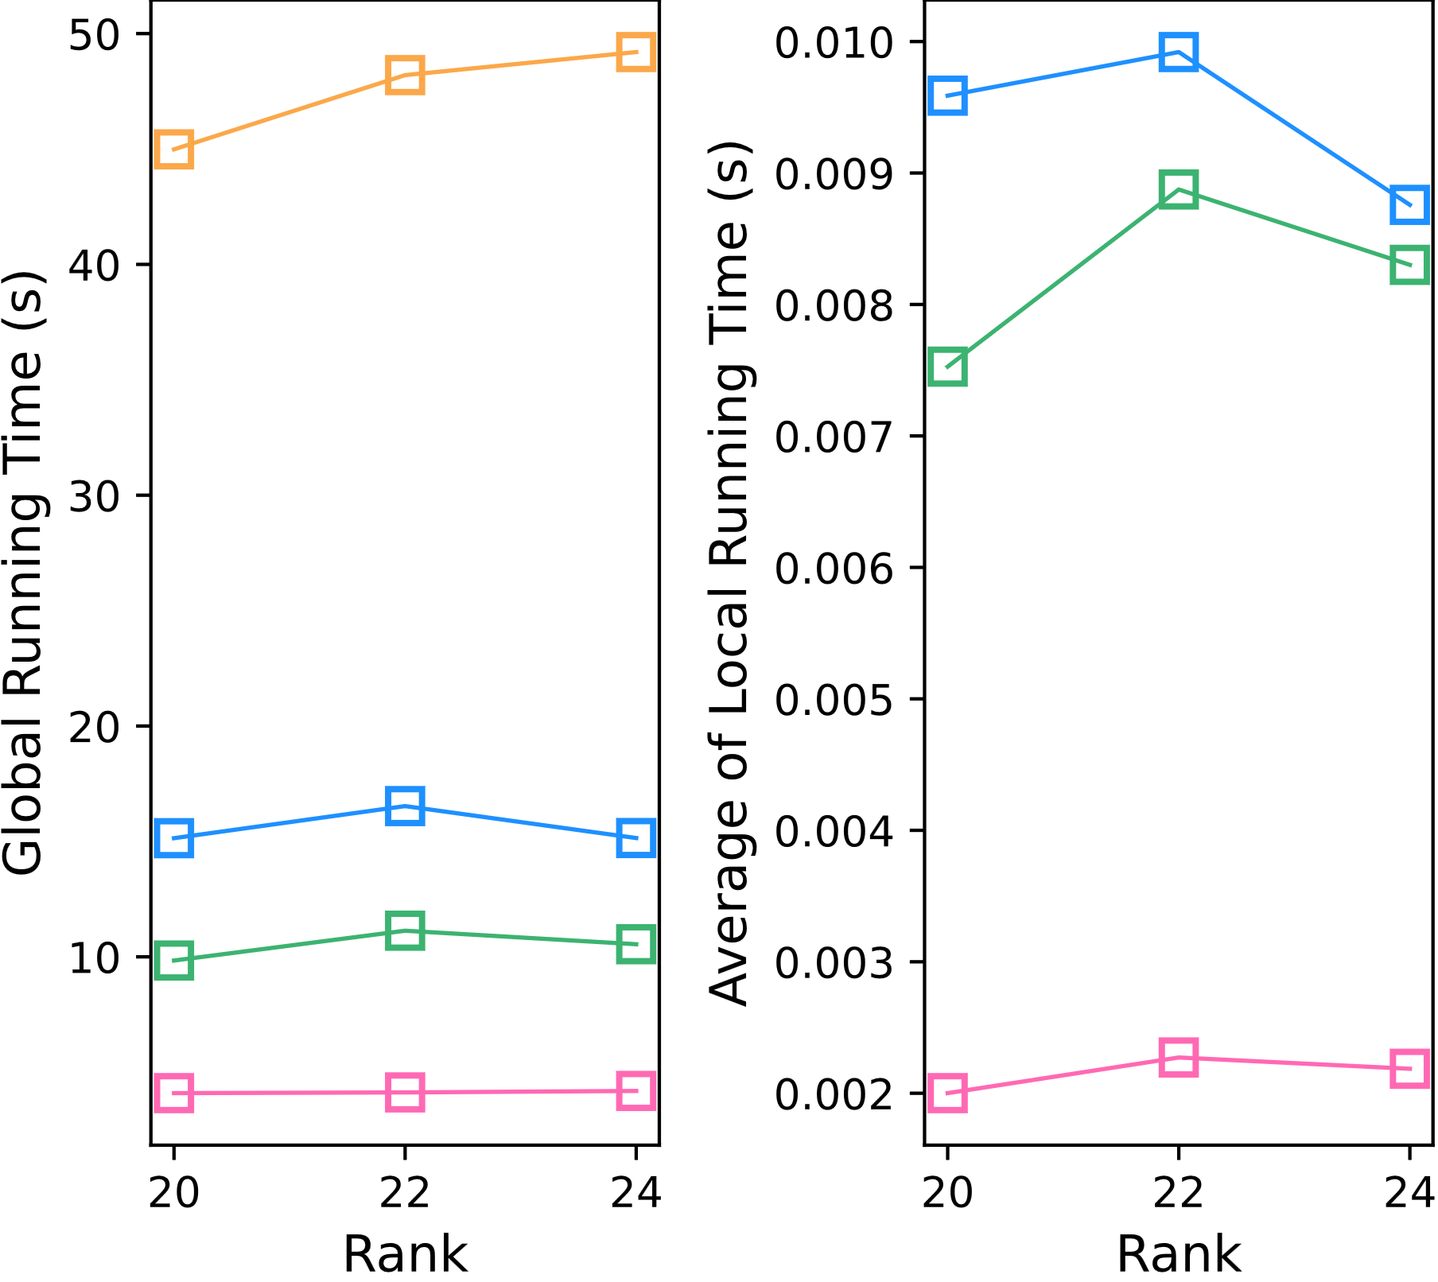
DAO-CP (proposed)
DTD
OnlineCP
Full-CP
BEST
BEST
BEST
BEST

Slide 11
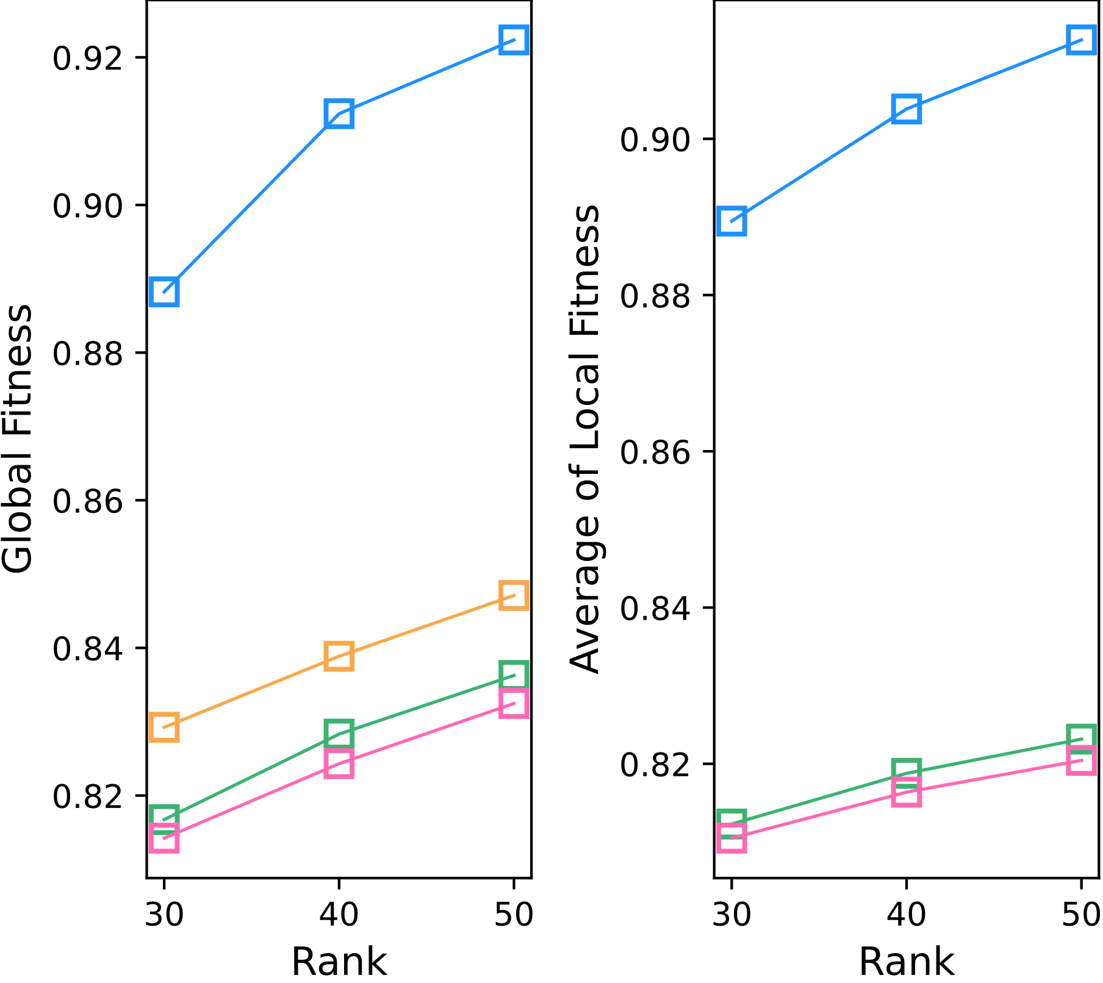
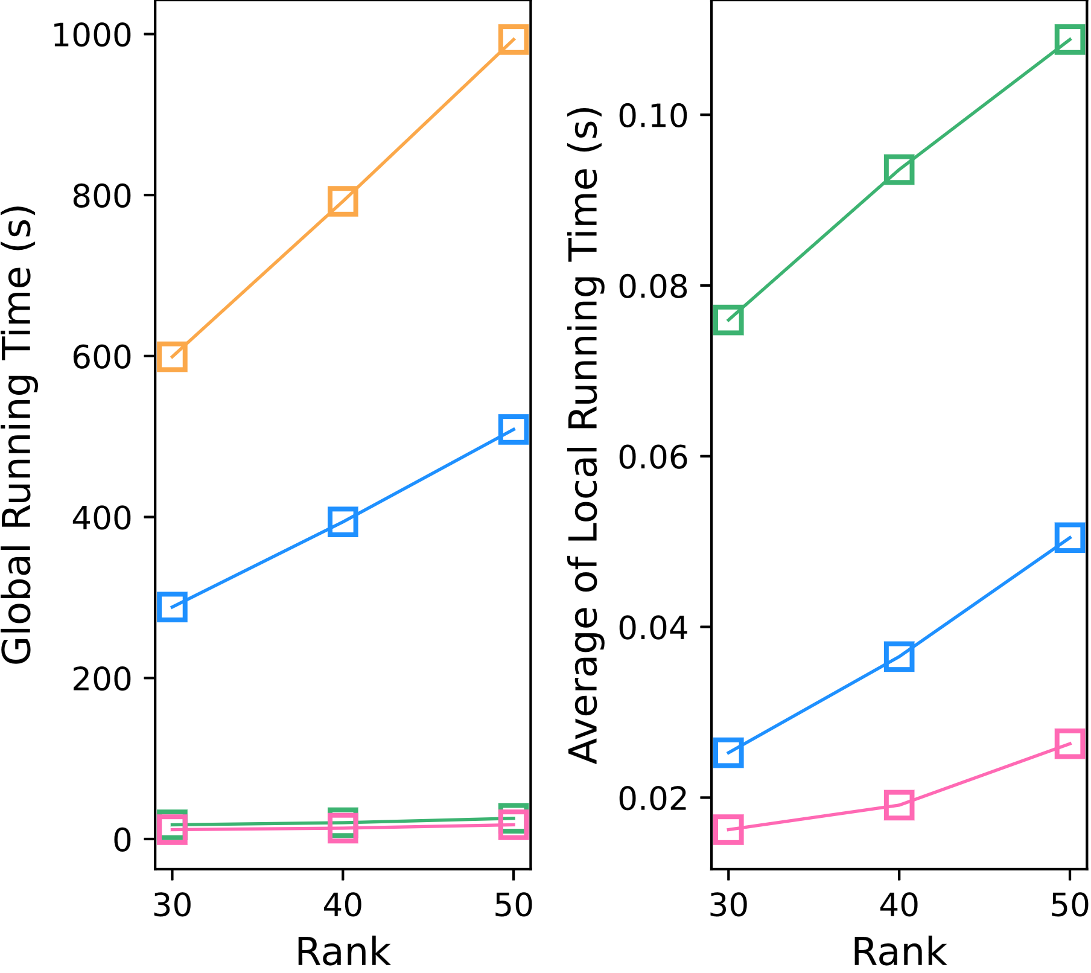
DAO-CP (proposed)
DTD
OnlineCP
Full-CP
BEST
BEST
BEST
BEST

Slide 12
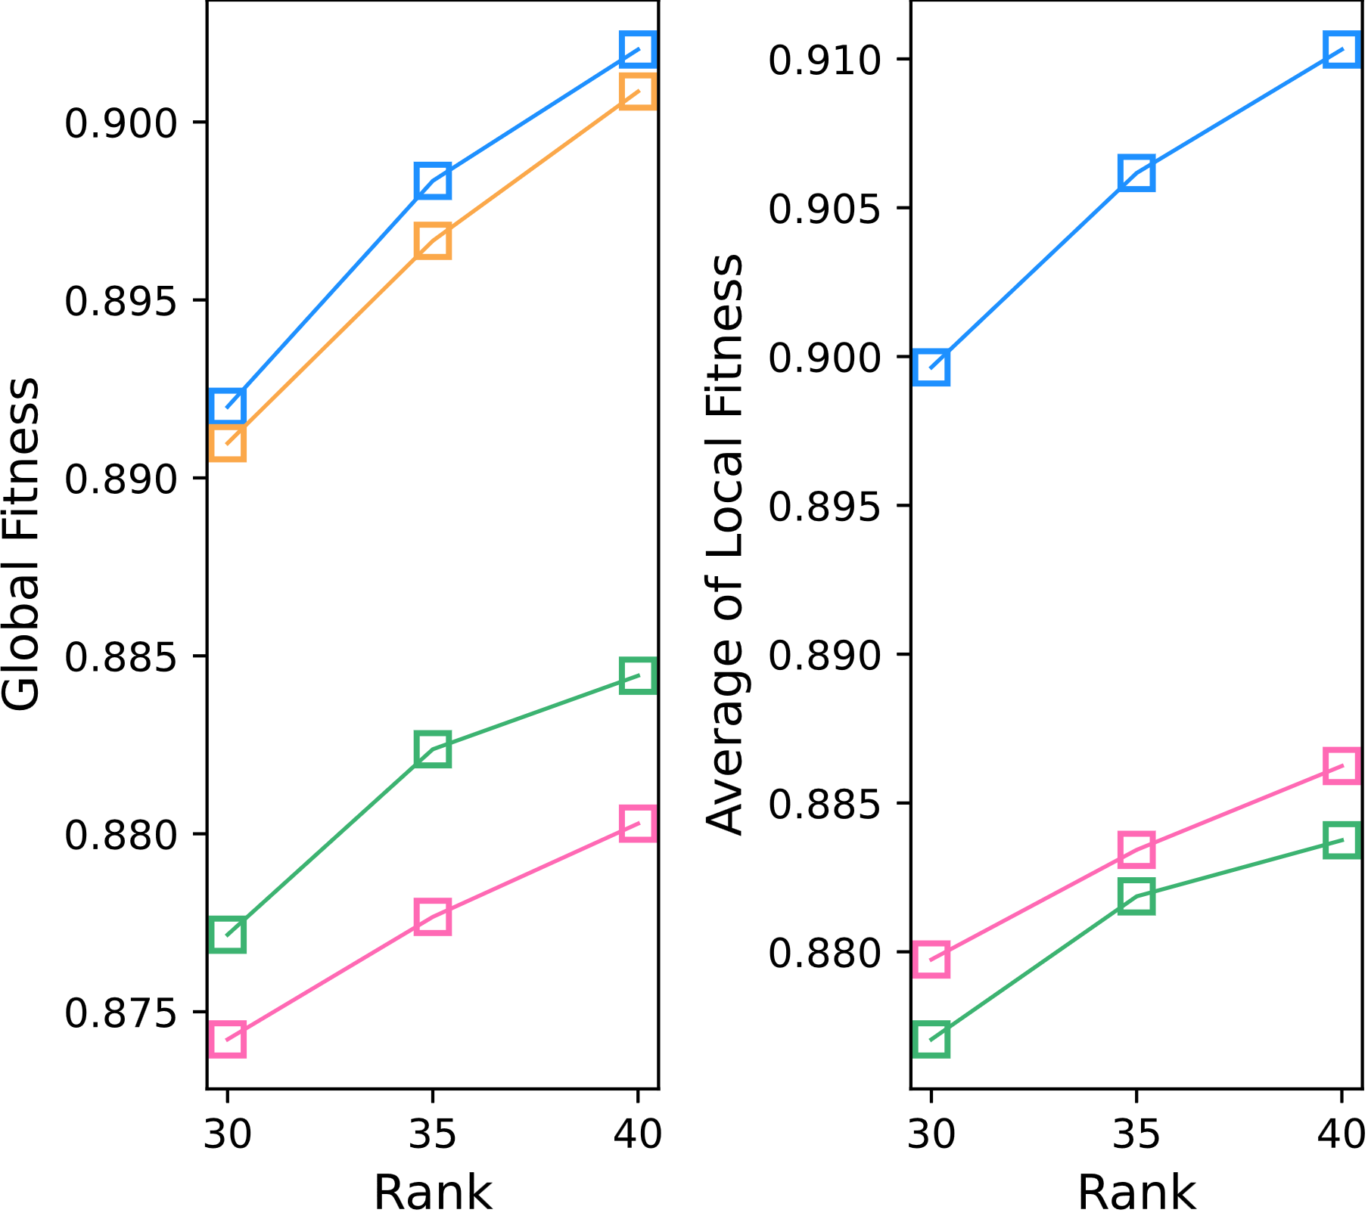
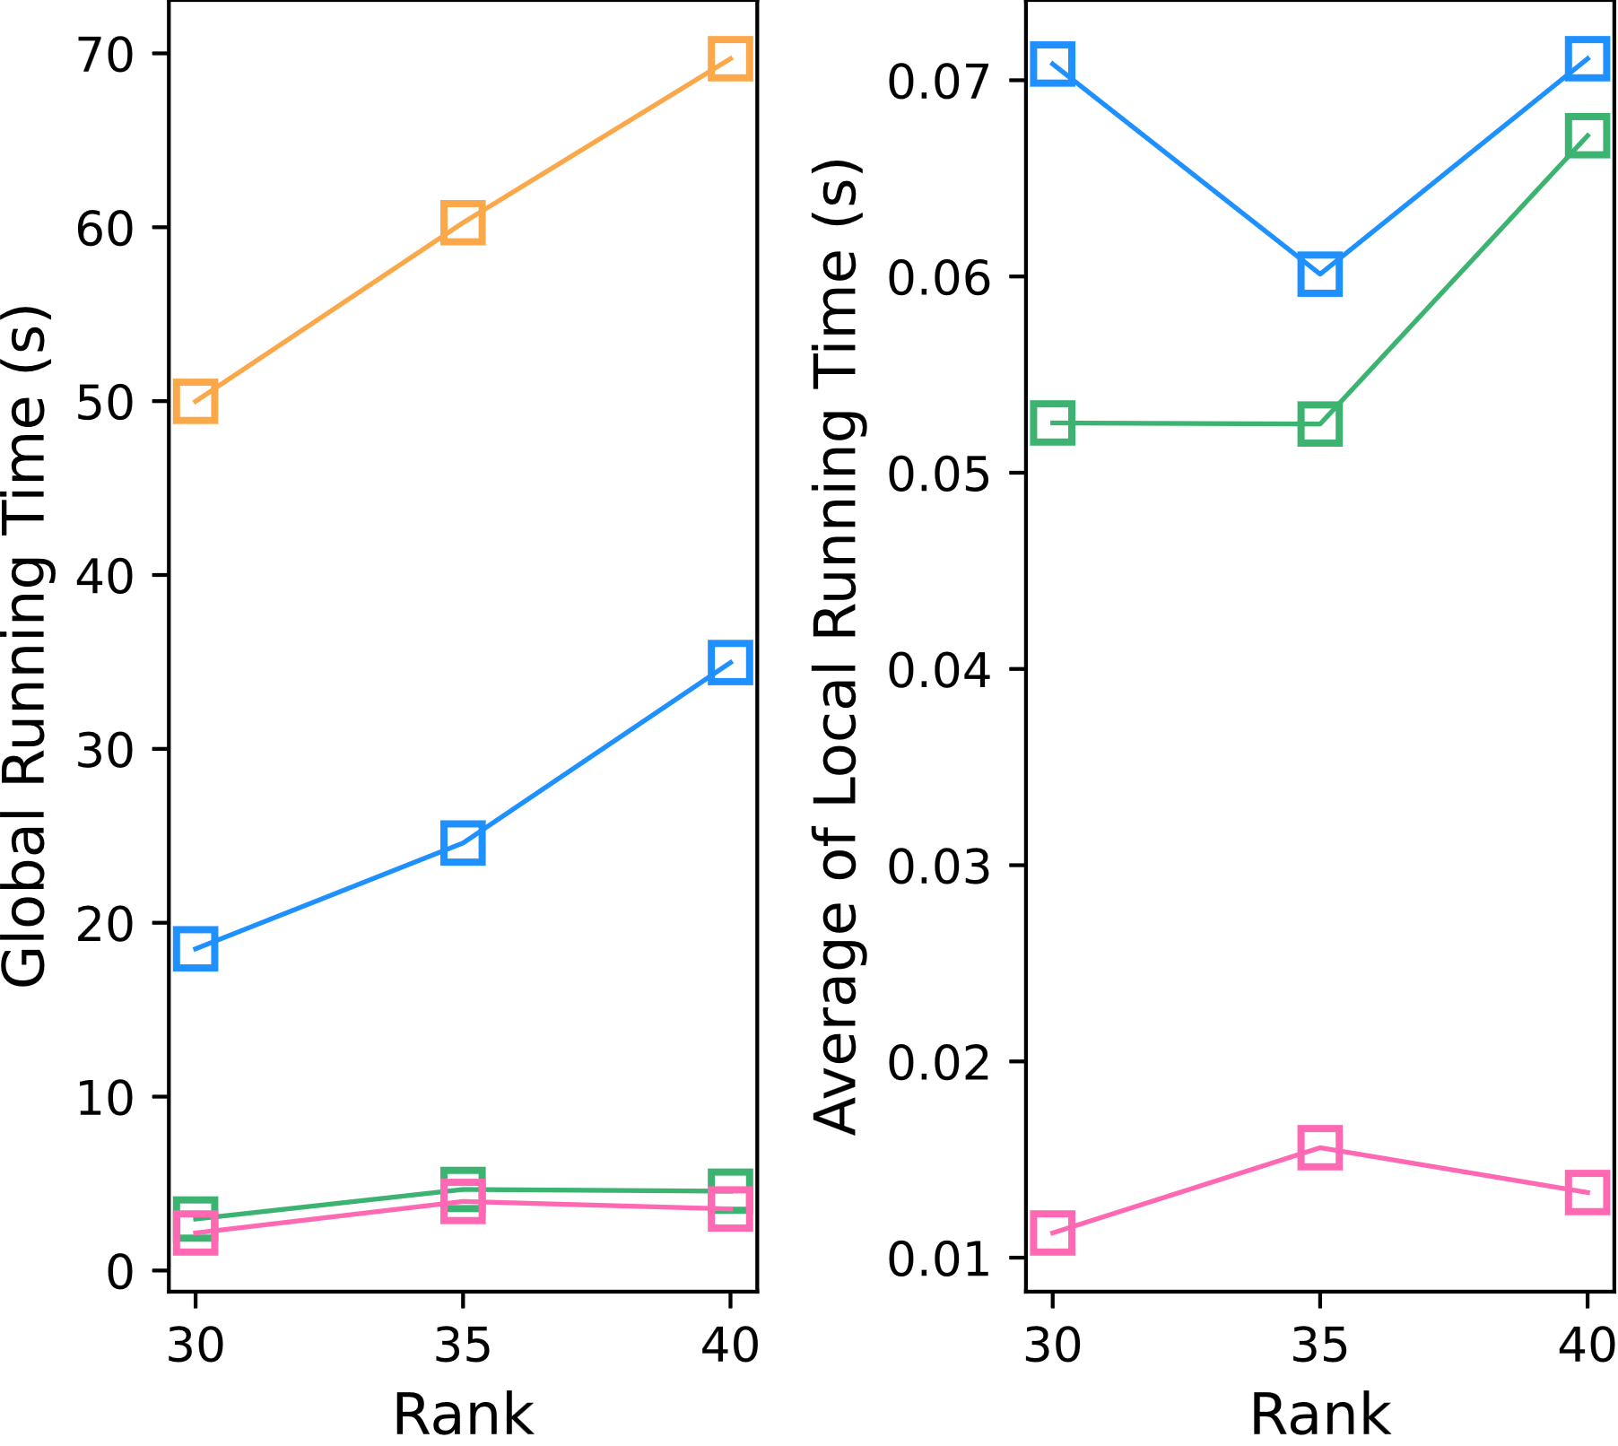
DAO-CP (proposed)
DTD
OnlineCP
Full-CP
BEST
BEST
BEST
BEST

Slide 13
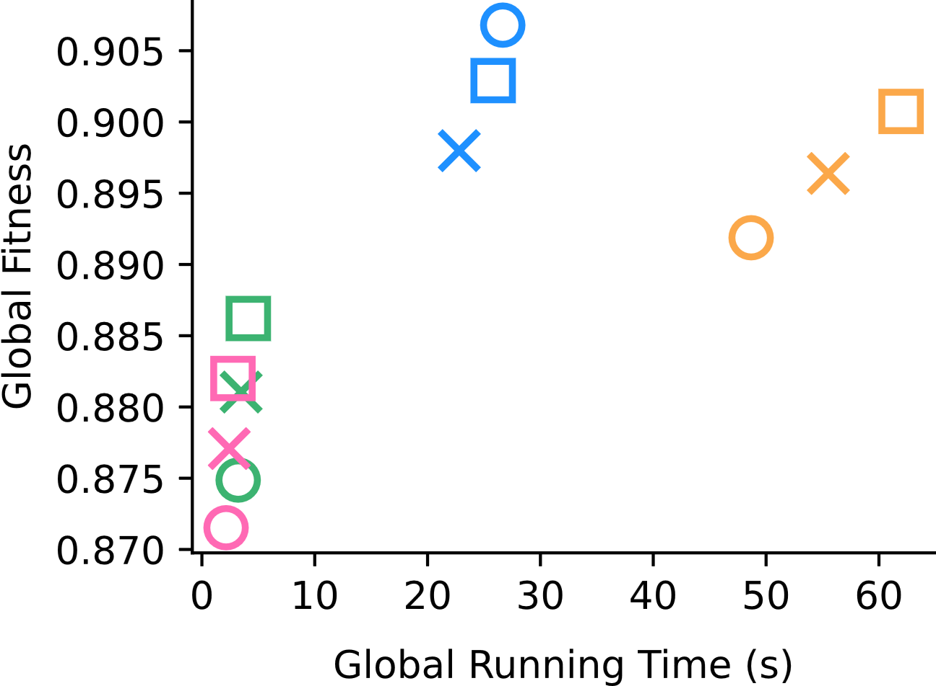
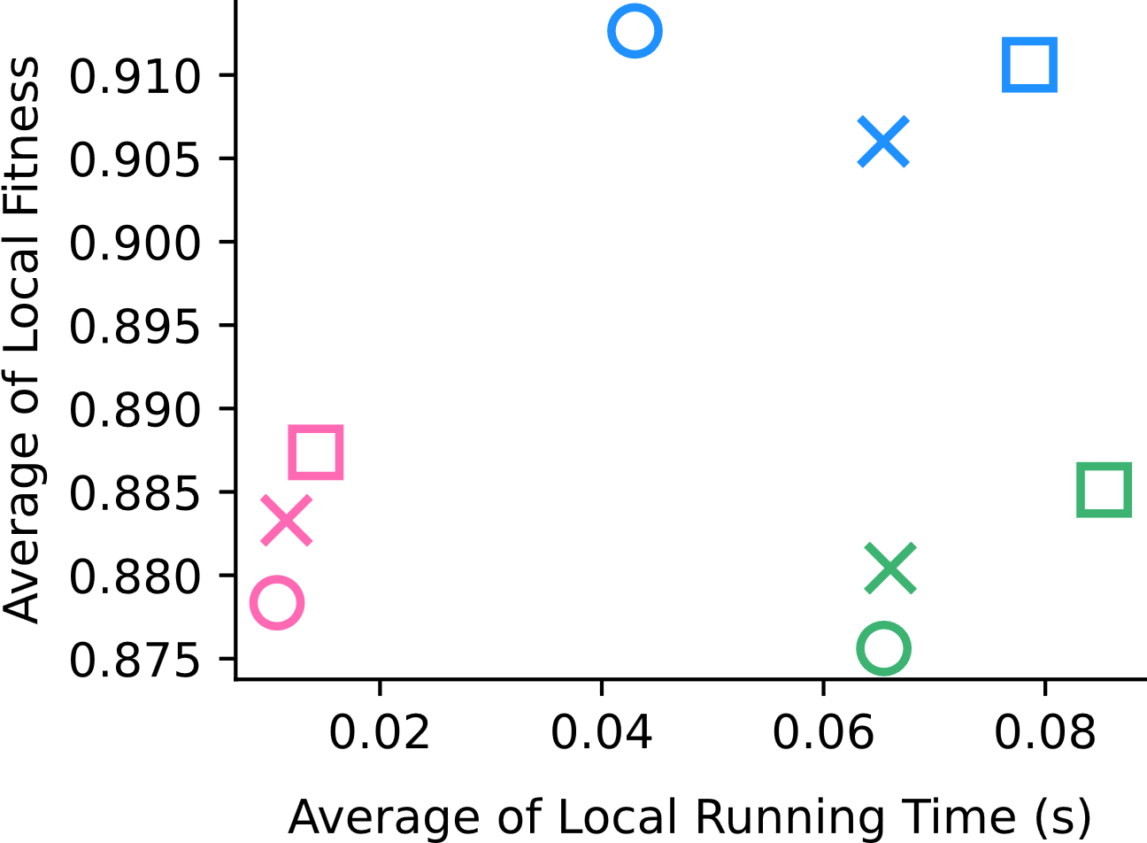
Hall (Rank 30)
Hall (Rank 35)
Hall (Rank 40)
BEST
BEST

Slide 14
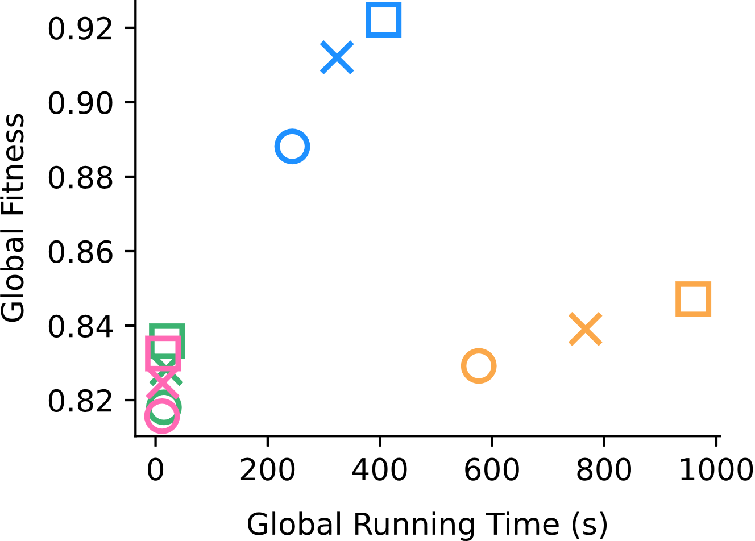
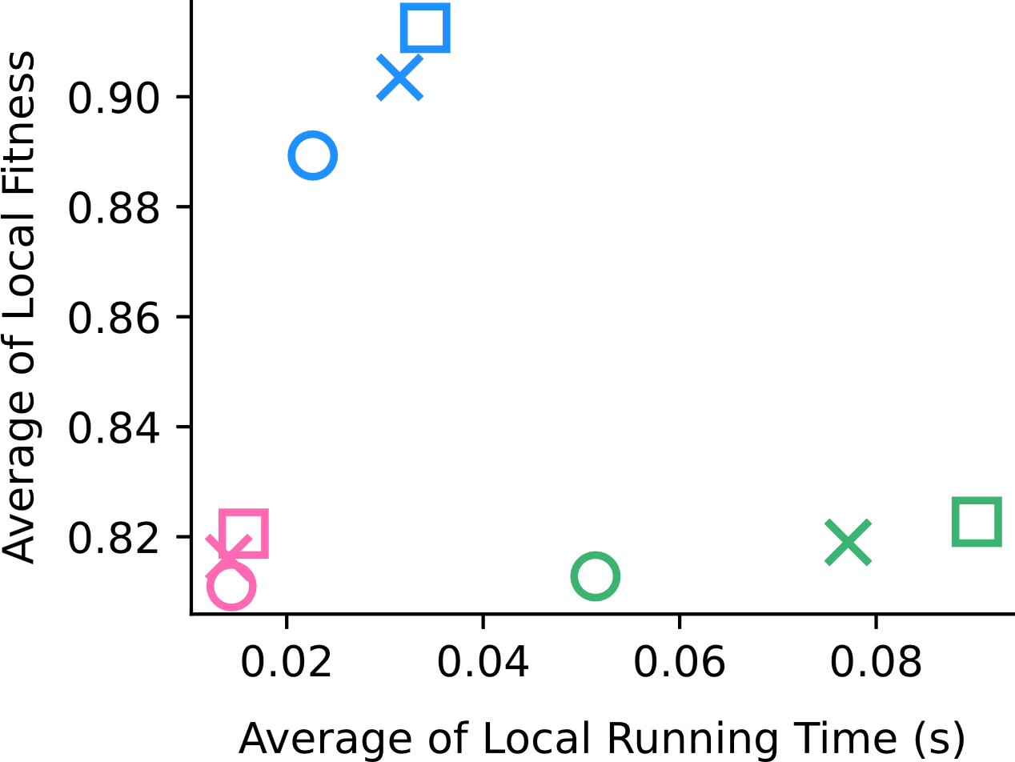
Korea (Rank 30)
Korea (Rank 40)
Korea (Rank 50)
BEST
BEST

Slide 15
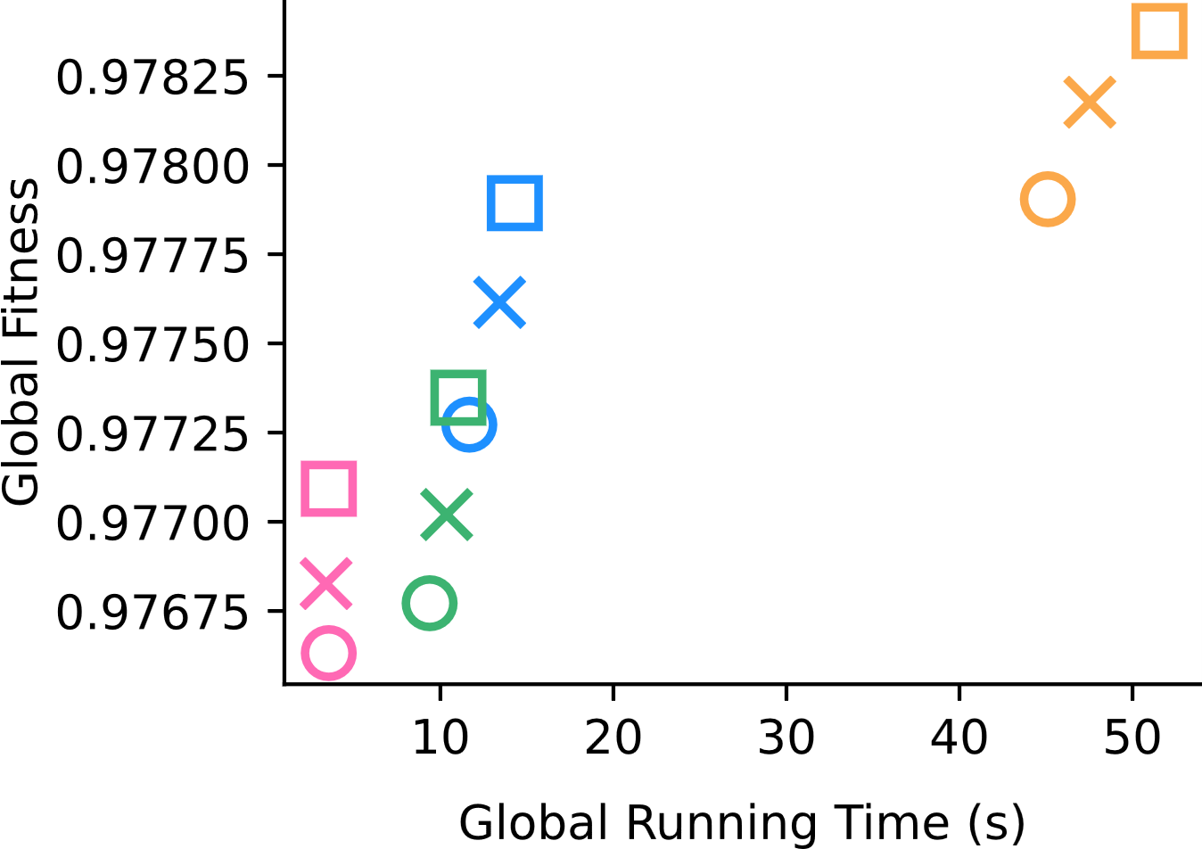
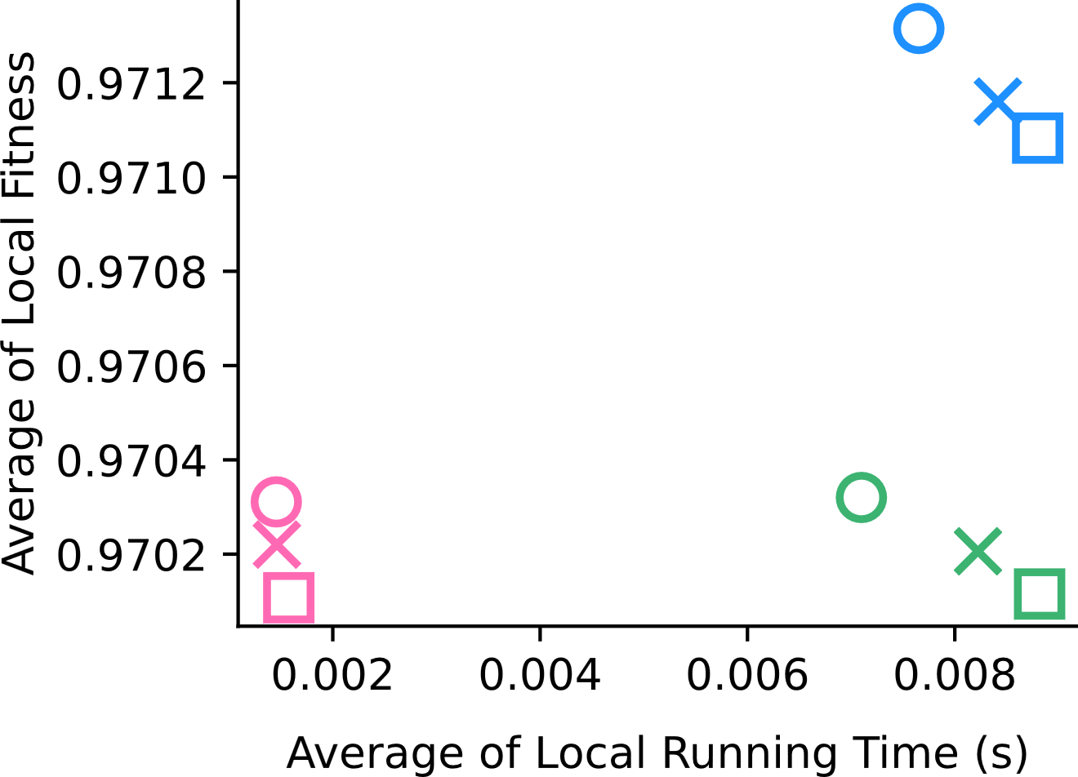
Stock (Rank 20)
Stock (Rank 22)
Stock (Rank 24)
BEST
BEST

Slide 16
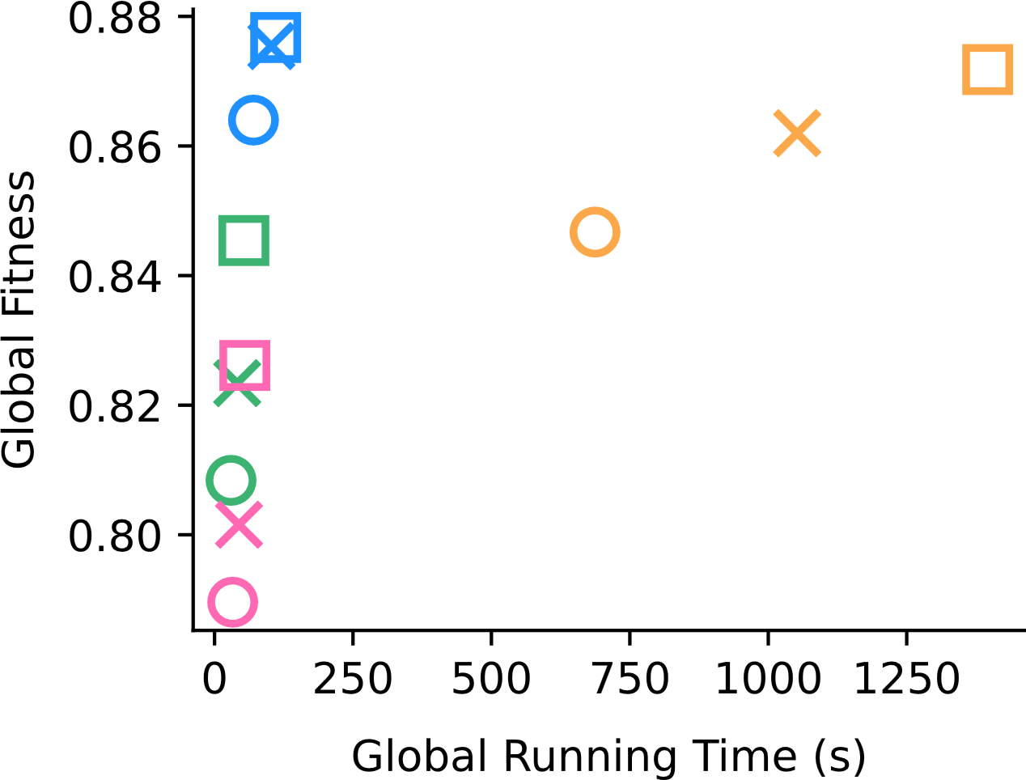
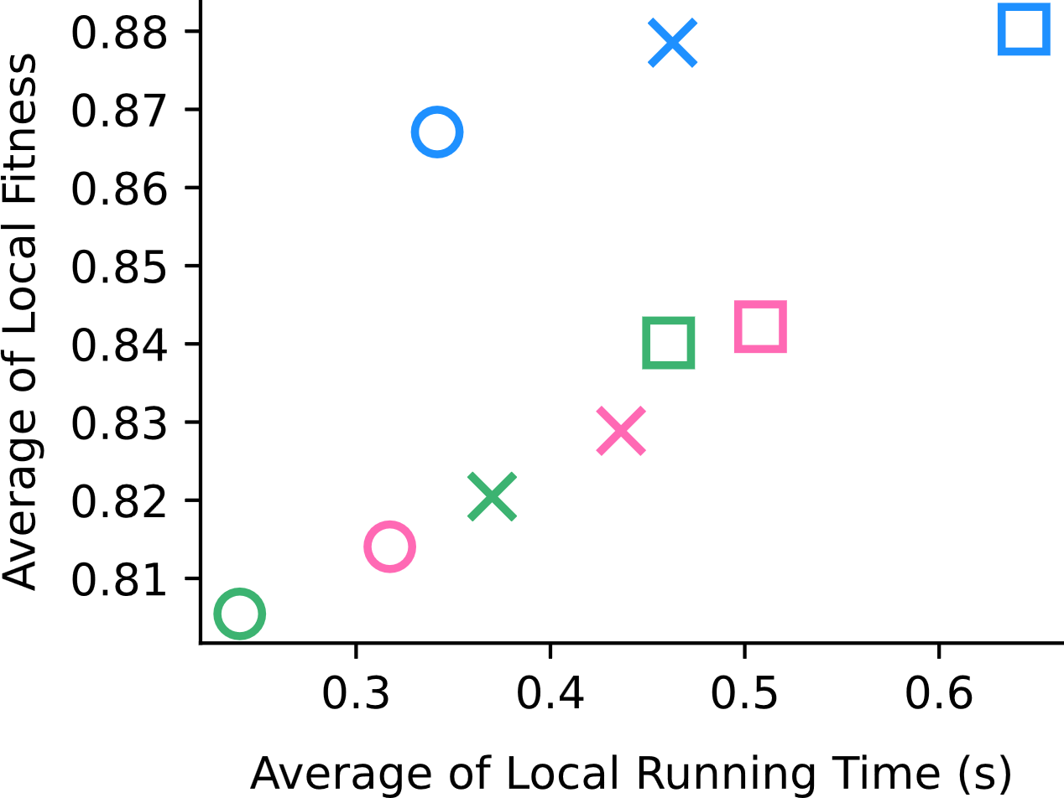
Video (Rank 20)
Video (Rank 30)
Video (Rank 40)
BEST
BEST

Slide 17
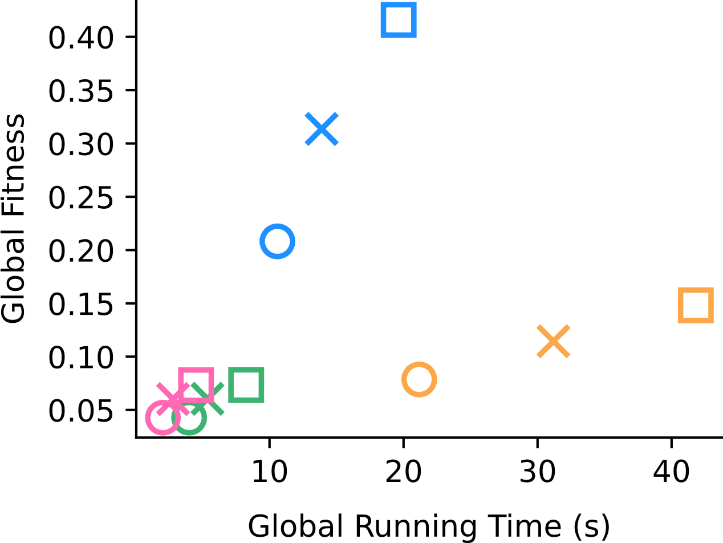
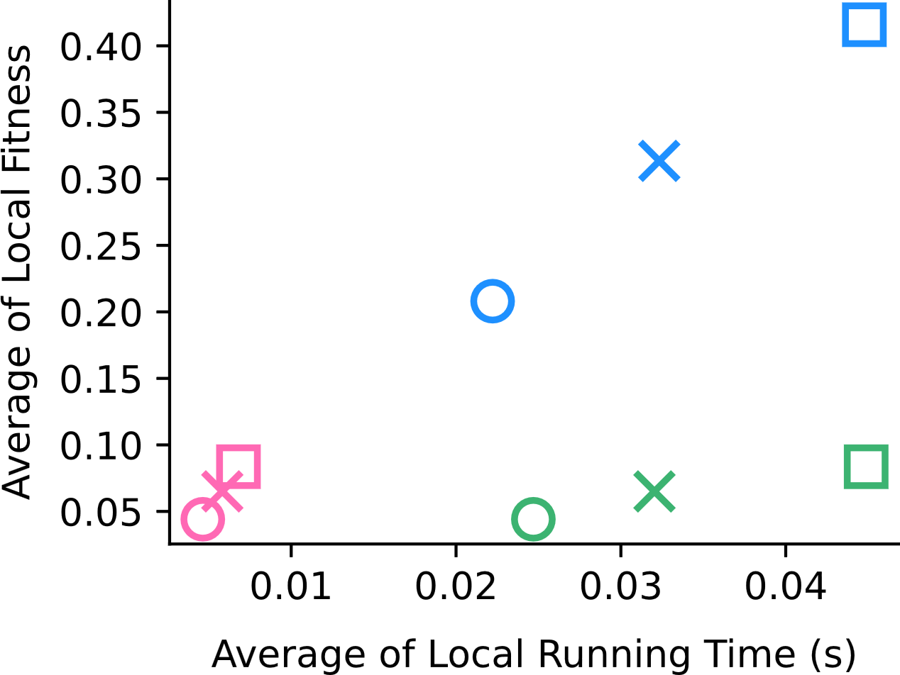
Synthetic (Rank 20)
Synthetic (Rank 30)
Synthetic (Rank 40)
BEST
BEST

Slide 18
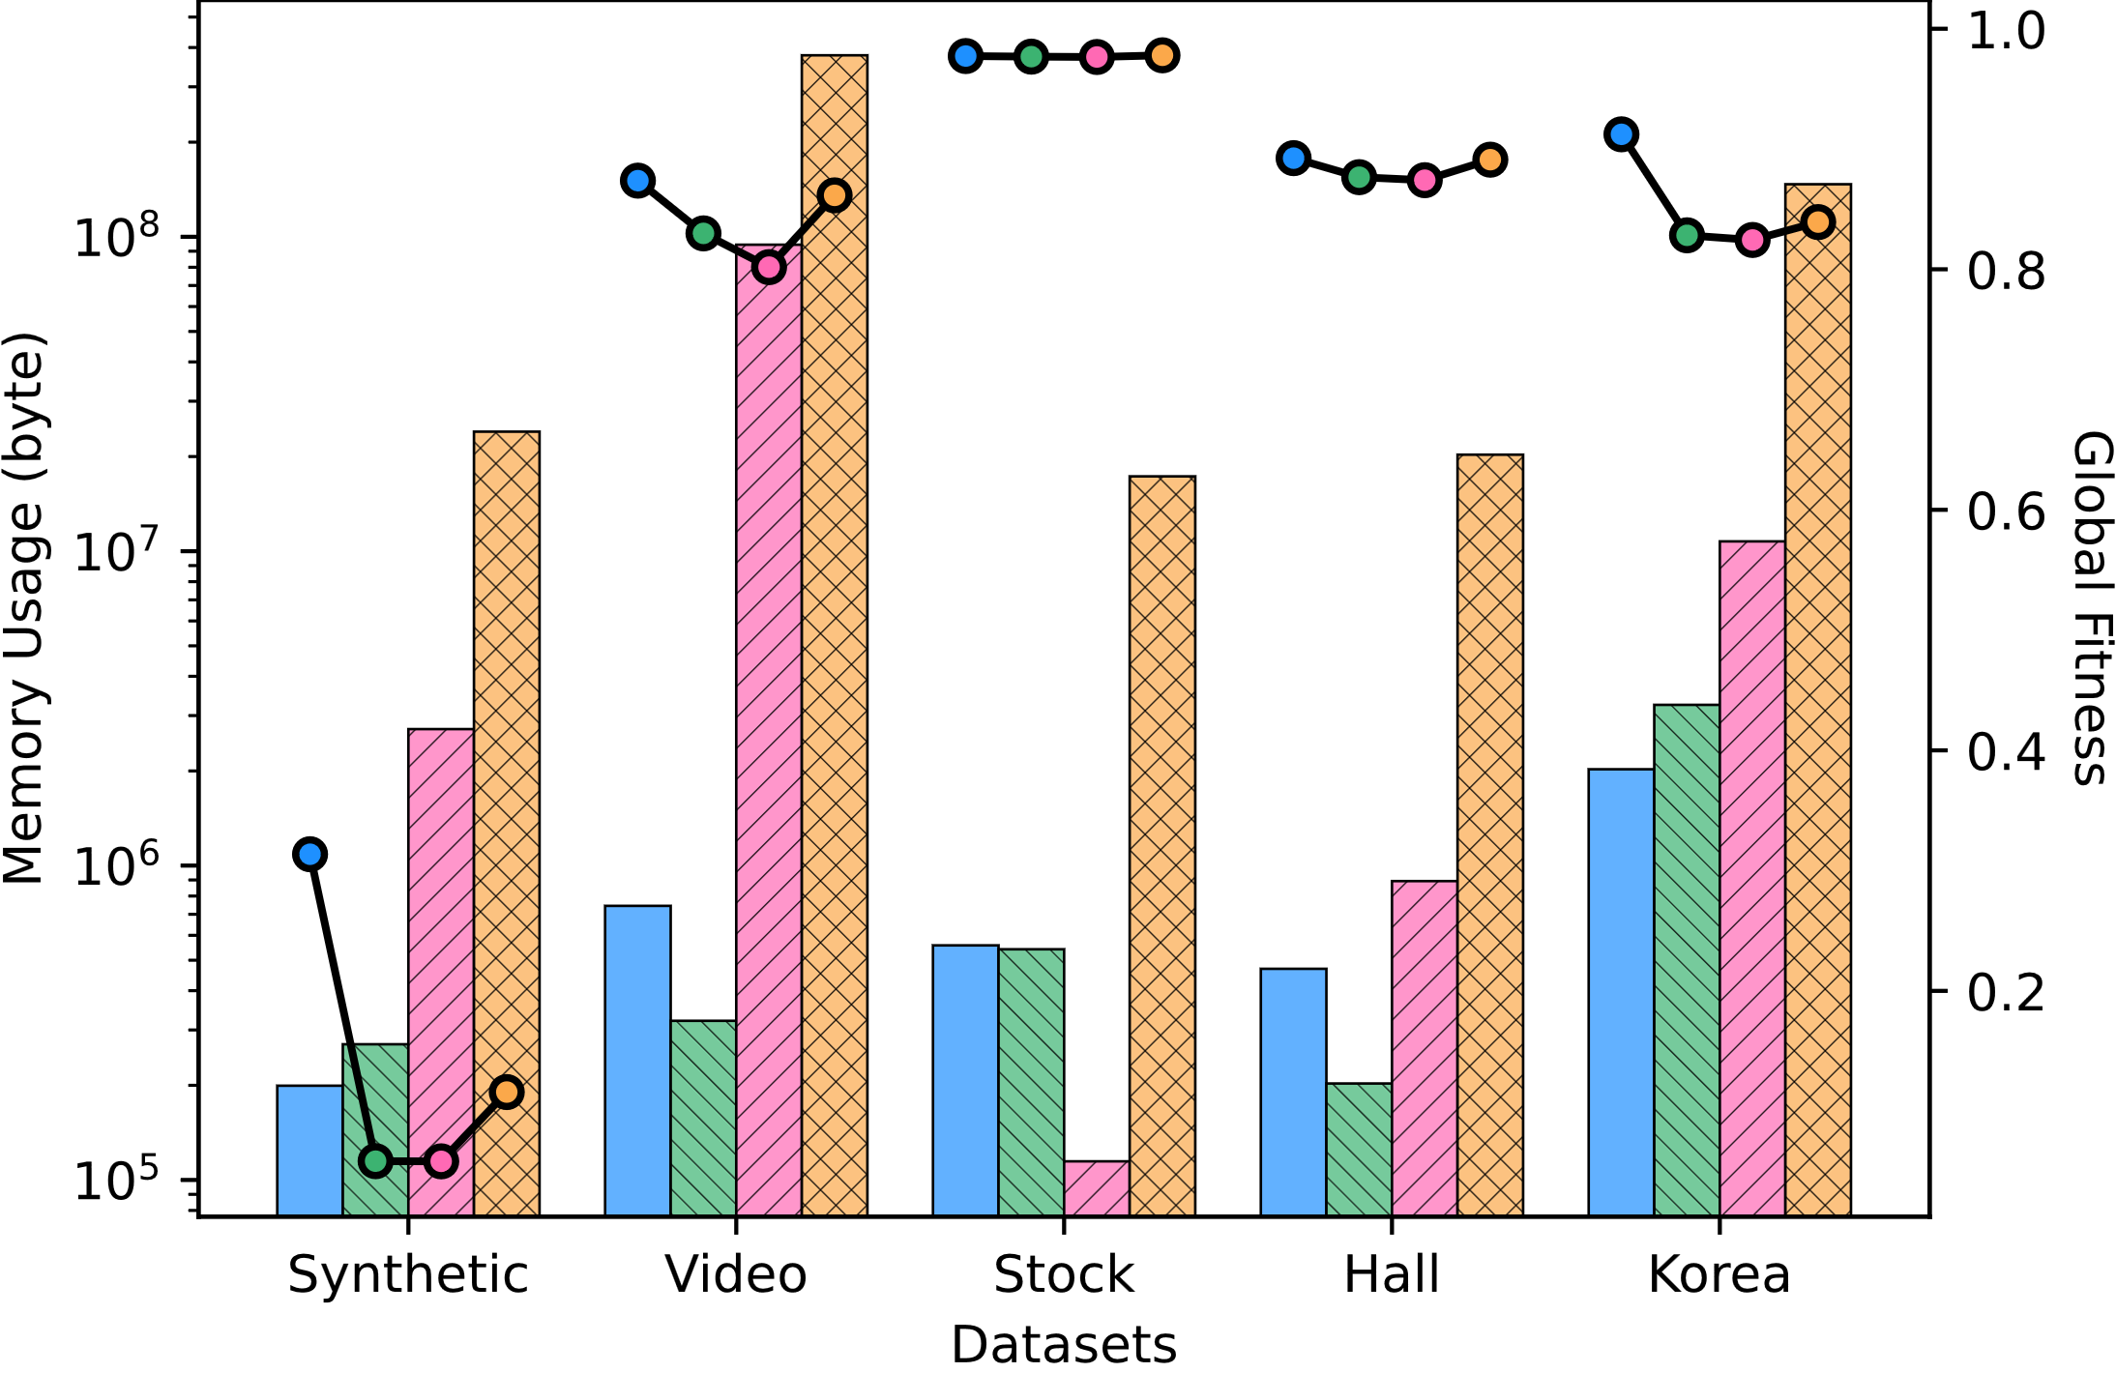
DAO-CP (proposed)
DTD
OnlineCP
Full-CP
73x
508x
31x
43x
120x

Slide 19
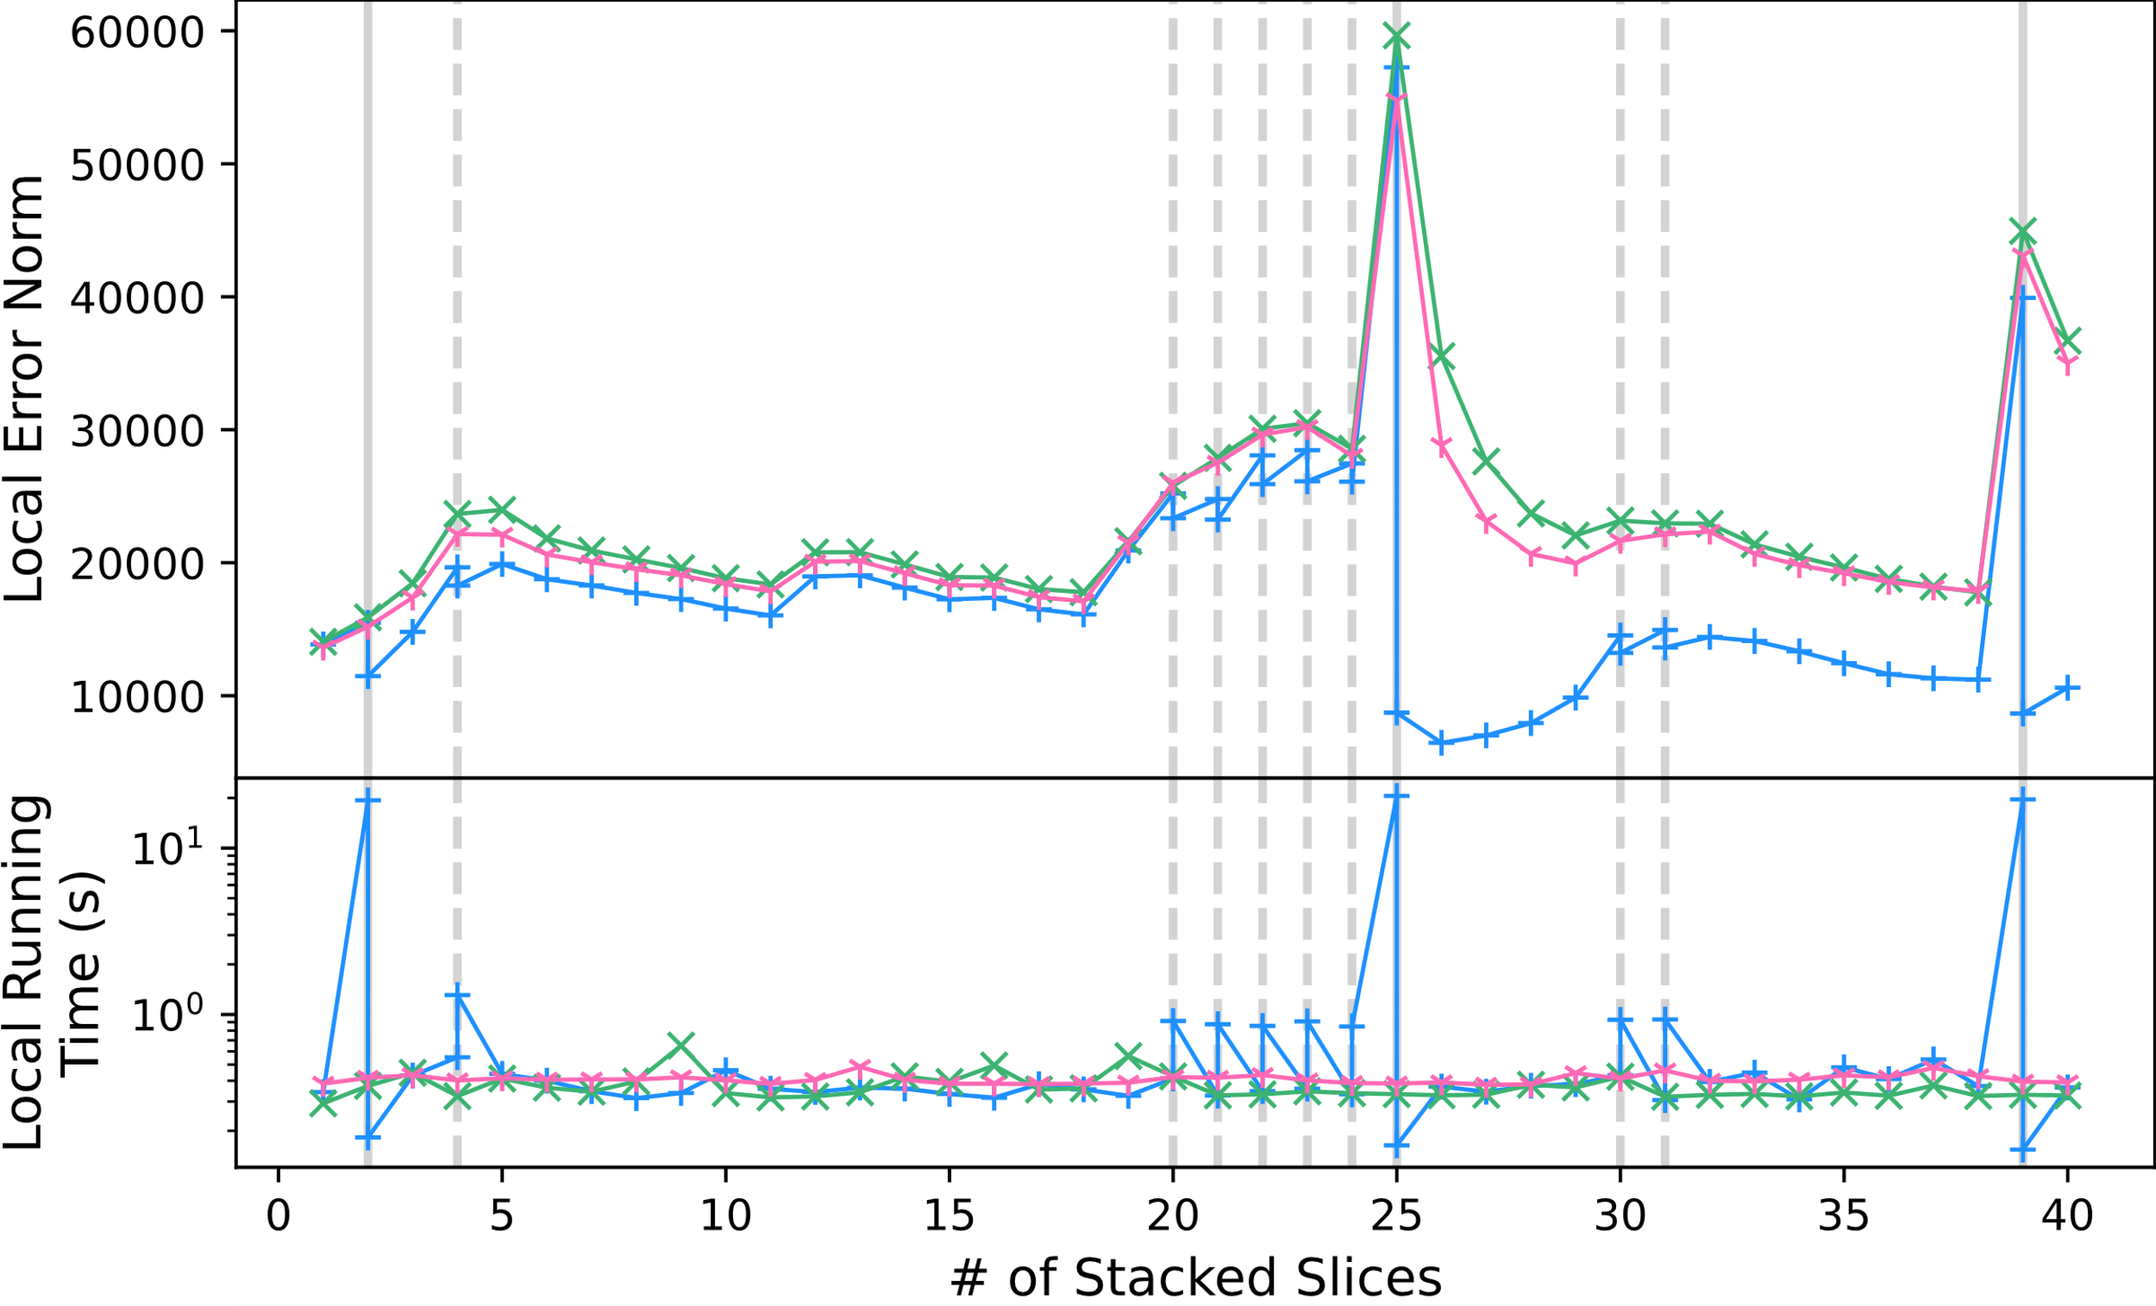
DAO-CP (proposed)
DTD
OnlineCP
split
split
split
refine
refine
refine
refine
refine
refine
refine
refine
A
6.56x
B
1.10x
BEST
BEST

Slide 20
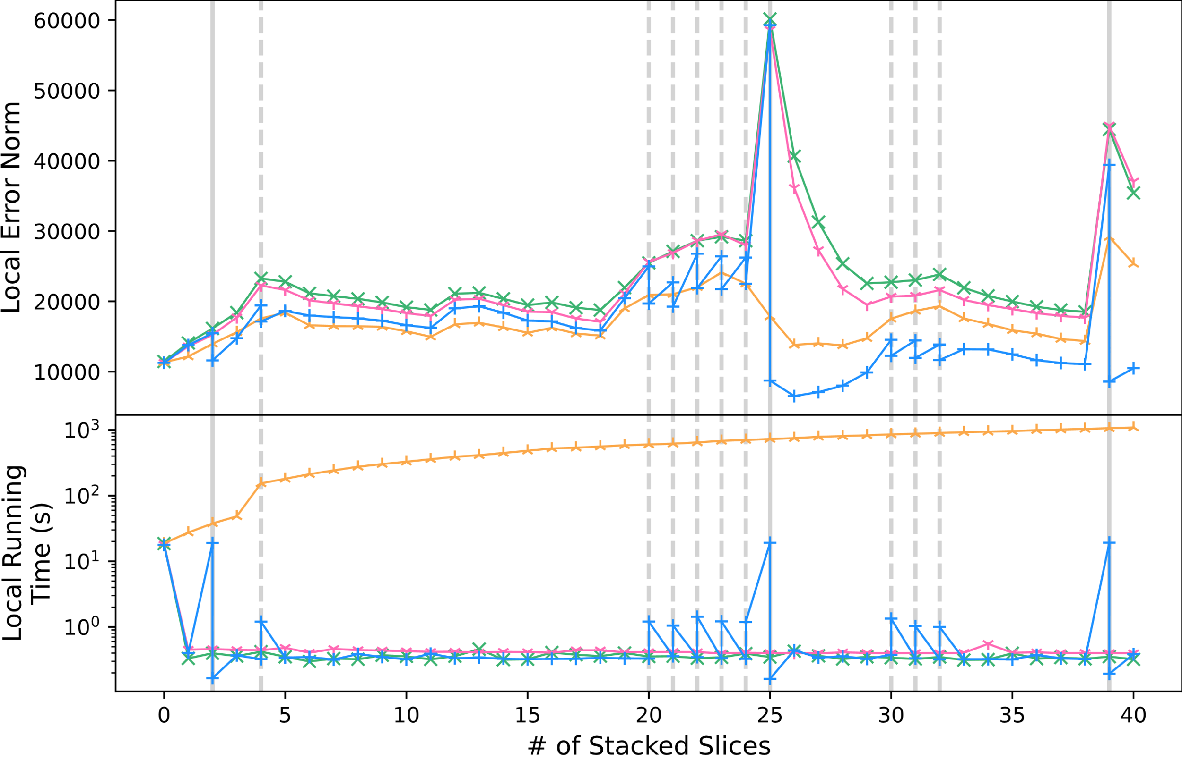
DAO-CP (proposed)
DTD
OnlineCP
Full-CP
split
split
split
refine
refine
refine
refine
refine
refine
refine
refine
refine
BEST
BEST

Slide 21





DAO-CP (proposed)
DTD
OnlineCP
Full-CP
split
split
split
refine
refine
refine
refine
refine
refine
refine
refine
refine
BEST
BEST

Slide 22
DAO-CP (proposed)
DTD
OnlineCP
Full-CP
split
split
split
refine
refine
refine
refine
refine
refine
refine
refine
refine
P1
BEST
P2
BEST

Slide 23
DAO-CP (proposed)
DTD
OnlineCP
Full-CP
split
split
split
refine
refine
refine
refine
refine
refine
refine
refine
refine
Pprev
BEST
Pnext
Qprev
Qnext
R
BEST

Slide 24
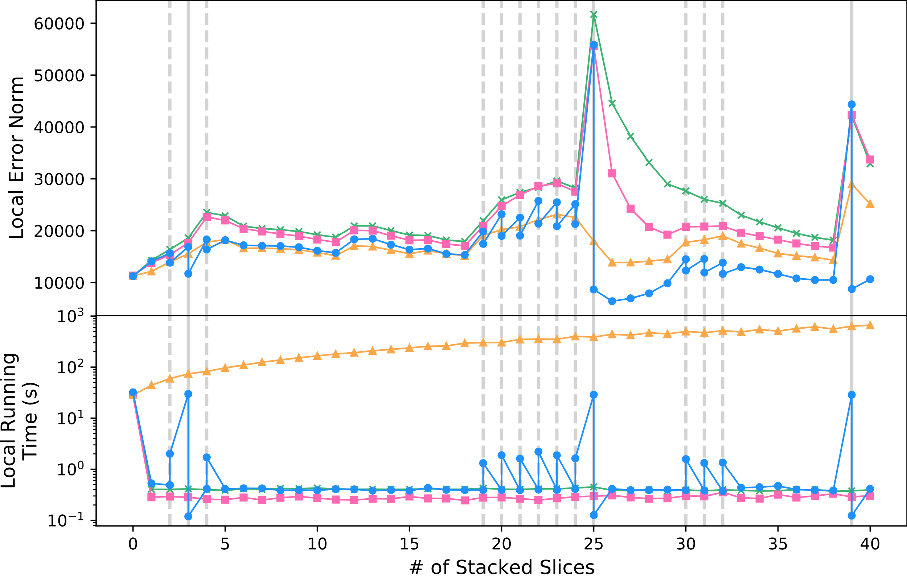
DAO-CP (proposed)
DTD
OnlineCP
Full-CP
split
split
split
refine
refine
refine
refine
refine
refine
refine
refine
refine
Pprev
BEST
Pnext
Qprev
Qnext
R
BEST

